Slide 1

Mathematical Reconstruction of Patient-Specific Vascular Network Based on Clinical Images and Global Optimization
Supervisor: Dr. Nima Maftoon
Students: Yifan Jiang, Abdul Hannan Faruqi, Junhong Shen

Slide 2
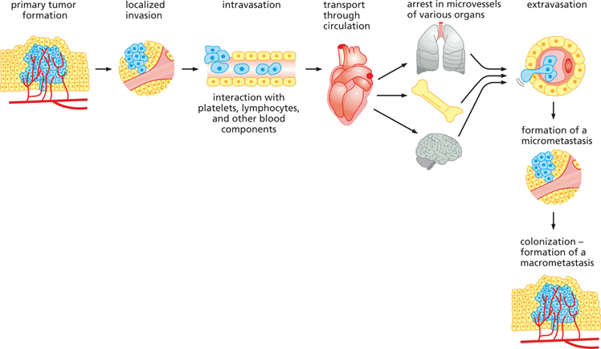
Motivation
Fig. 1 Metastasis
Modelling tumor growth and its vascularization
Blood flow plays a vital role in metastasis.
To study circulating tumor cells in metastasis and the location of secondary tumor sites detailed geometry of vascular network is needed.
Our computational framework is aimed at providing this detailed network structure which could aid in predicting metastasis sites.
Notes:
To metastasize, the cancer cells must detach from the primary tumor, intravasate into the bloodstream or lymphatic system, avoid immune protection, extravasate from the blood, finally migrate to distant organs, and proliferate to a secondary tumor.
More than two-thirds of metastatic sites could be explained by the blood flow links between the primary and secondary sites

Slide 3
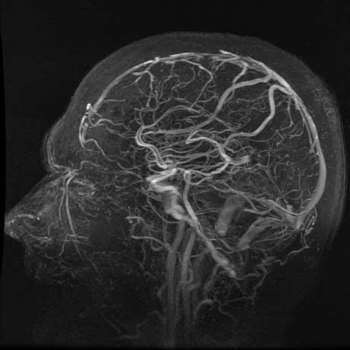
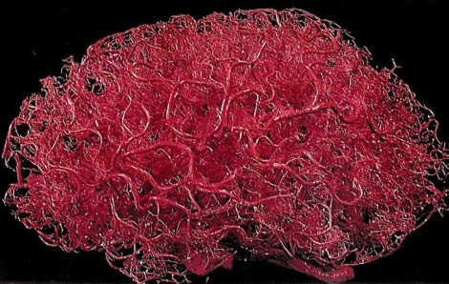
Patient-specific Vascular Network
Fig. 2 Brain Angiography
Fig. 3 Idealized Brain Vascular Network

Slide 4
Our Framework
Image-based 3D Vessel Reconstruction with Structure Approximation
Medical Image Preprocessing
Large Vessel Extraction
Optimization-based Structure Refinement (Global Constructive Optimization)
Volume Generation
Postprocessing
Global optimization solved by GCO: merge / split / prune
Local optimization solved by relaxation

Slide 5
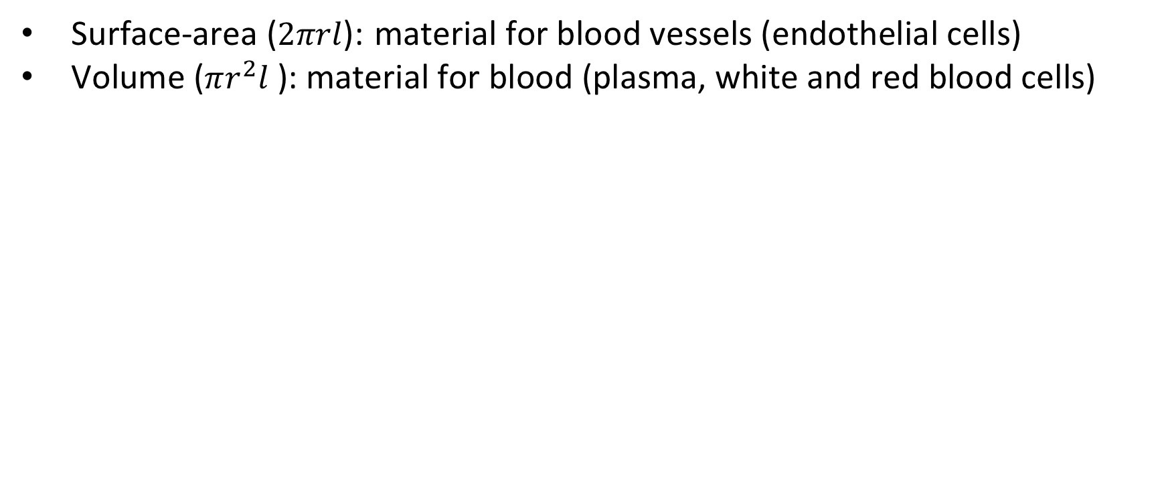
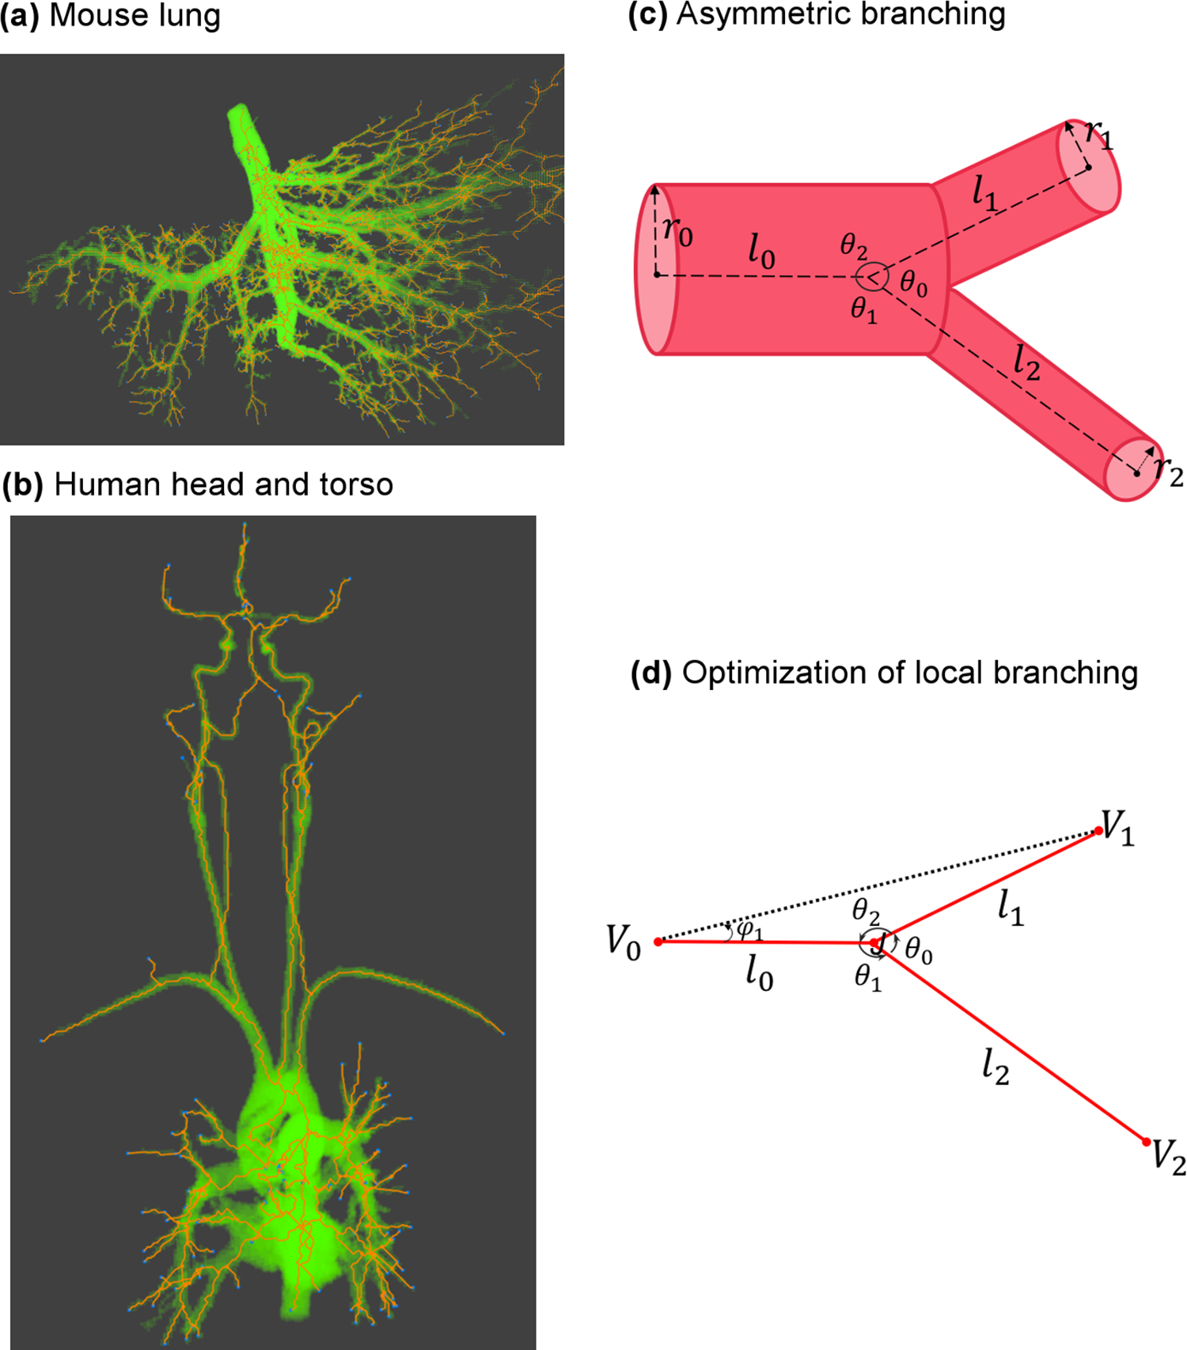
Cost Function: Material Cost
Fig.4 3D Model of Bifurcation
Notes:
using GCO, reason for optimization, physiological assumption: departure from optimal vascular structures in human body might cause disease
step relaxation
material cost represents for material needed for blood vessel
cells form the wall; cells in blood
model the vessel as cylinder, fix find optimal cost function minimize
actual implementation 3000

Slide 6
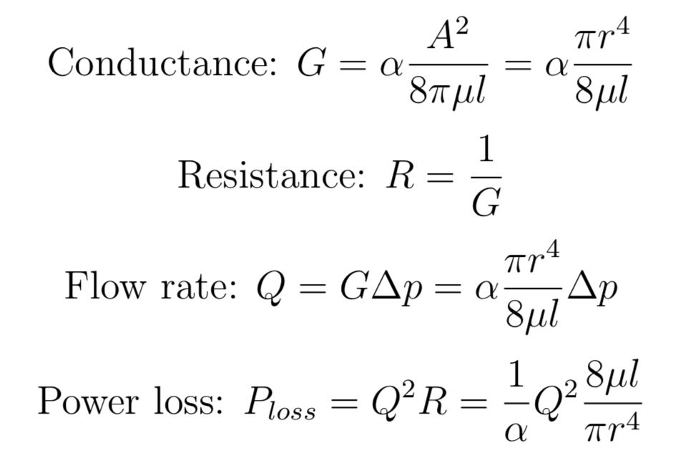
Cost Function: Power Cost
Power loss during blood circulation
Notes:
energy dissipated during circulation, this is modelled according to laws in fluid dynamics
calculated by
flow rate is determined by flow of single cross-section that cut through all vessels at the same branching level
depends on radius, length, v, pressure diff of extreme ends
model the power loss as something like a circuit, consider the flow rate to be current, treat actual blood flow to be resistor

Slide 7
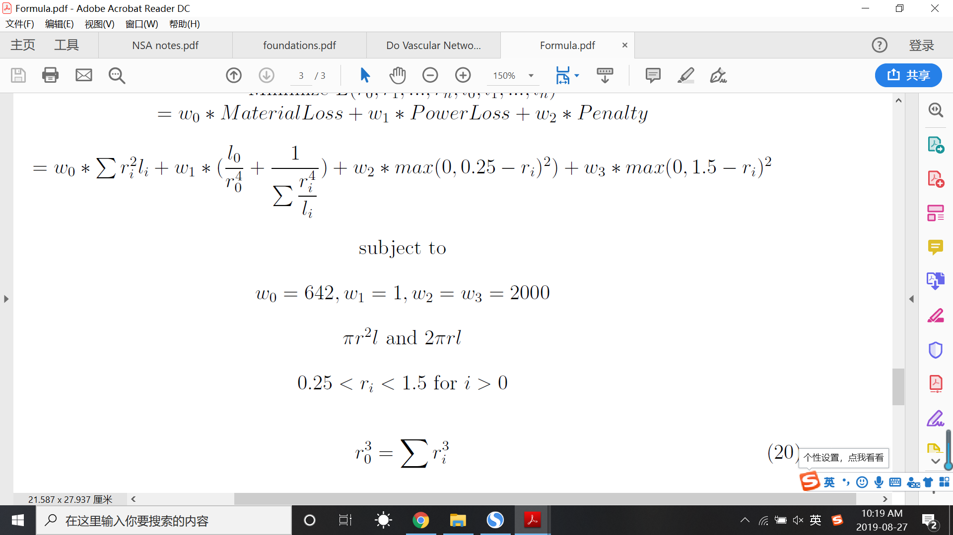
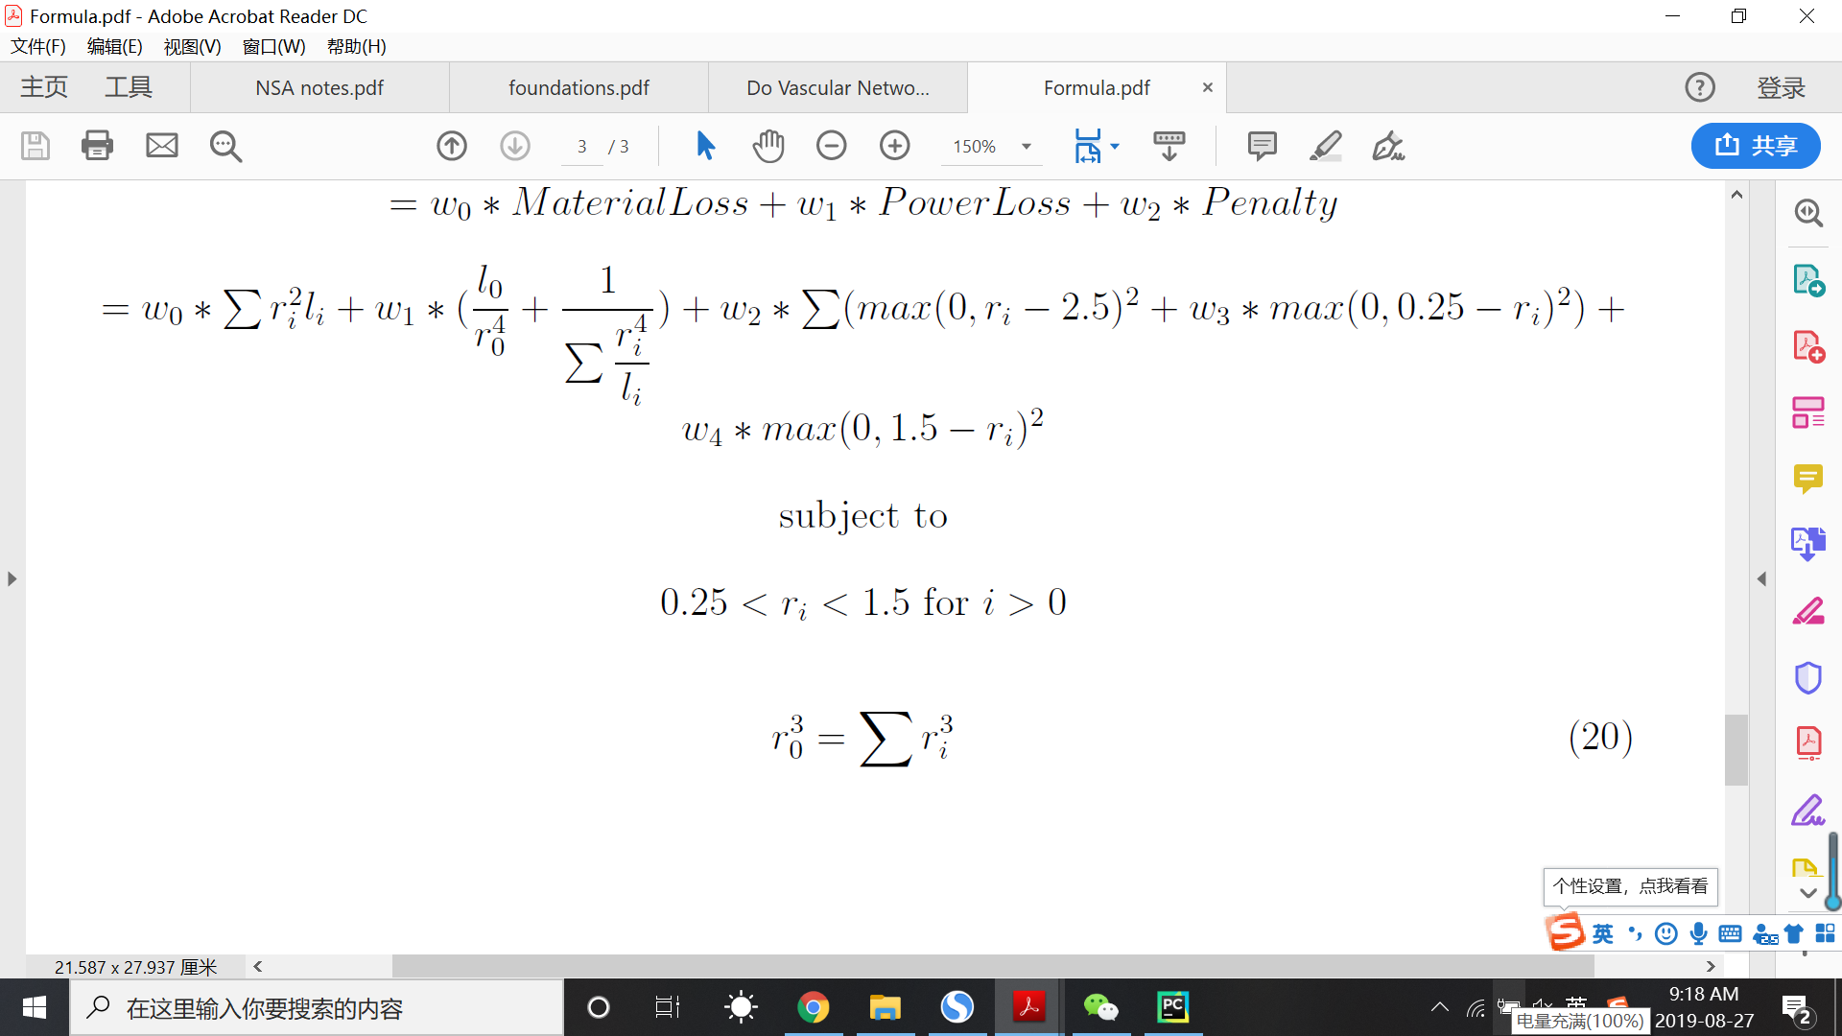
Cost Function for Relaxation
subject to:
Fig.5 Illustration of MC
Fig.6 Illustration of PC
Notes:
combine
pressure from main vessel to each branching vessels are approximately equal, treat vessel structure to be parallel circuit
main vessel = main circuit
branching vessel = branching circuit
by research, found the range of radius
by murrays law, the relation between the radius of main vessel and the radius of the branches
power cost become large
need to assign weight to make them have equivalent effects on the cost function
refer to previous work as well as the result from our own experiment

Slide 8
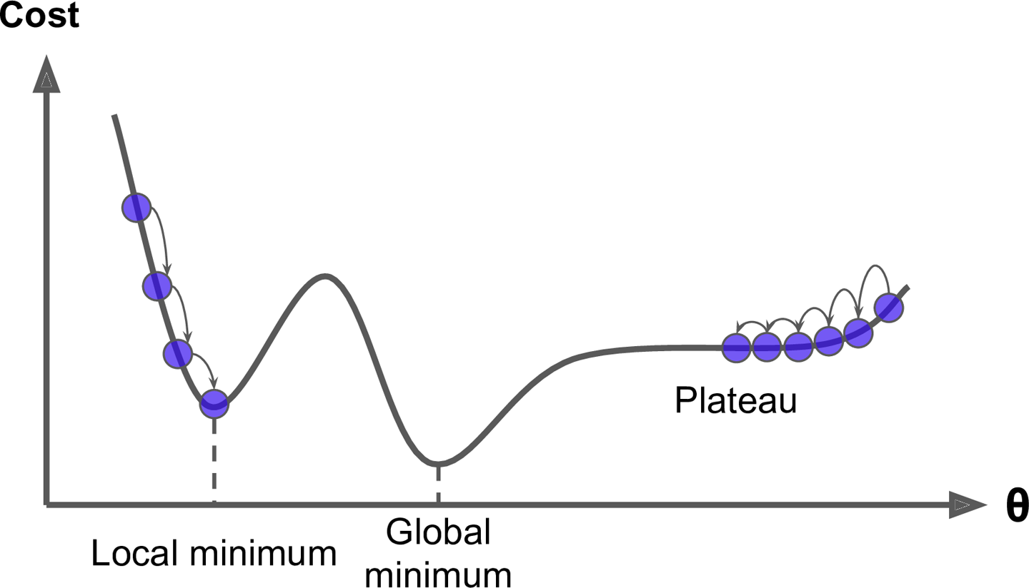
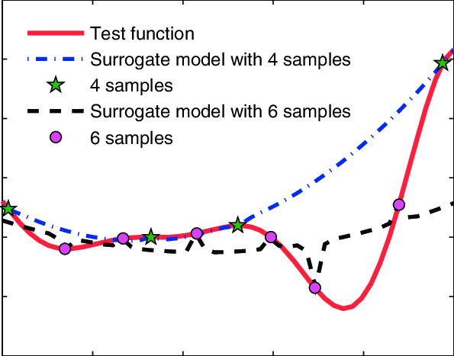

Optimization Algorithms
Surrogate-based Modelling
Approximates the actual objective function based
on sampled points and then gives the minimum
Gradient-Descent
Follows the gradient to reach the
optimum point
Simulated Annealing
Samples multiple points in the domain
and then narrows down to an optimum
Fig.7 Cost Change for GD
Fig.8 Cost Change for SM
Fig.9 Cost Change for SA

Slide 9
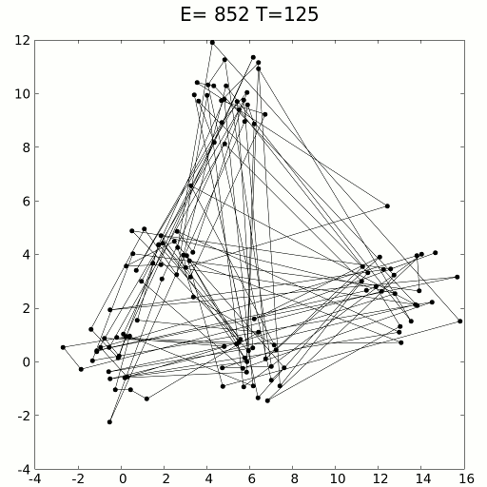
Optimization Algorithm
Simulated Annealing
An optimization method inspired by annealing process in metallurgy.
Has high probability of acceptance in the beginning and it decreases with temperature (iterations).
Finds the global optimum when there are multiple local optima.
Fig. 10 Simulated Annealing Example

Slide 10
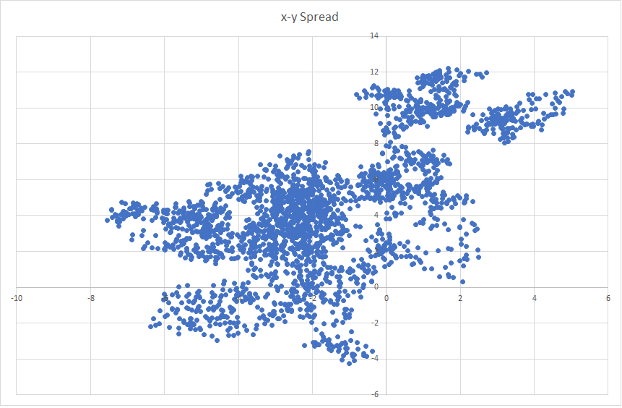
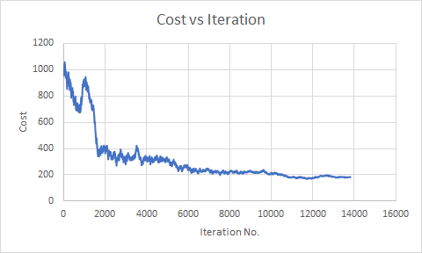
Optimization Algorithm
Finding the global minimum using simulated annealing.
Fig.11 Location Change of Points
Fig.12 Change of Cost Function

Slide 11
Optimization Algorithm: Parameters
Important parameters for Simulated Annealing:
Temperature (Chosen value = 1)
It defines the acceptance probability of a bad move. (Good moves are always accepted)
Cooling coefficient (Chosen value = 0.999)
It affects the ability to reach equilibrium
Move Function (Function = [-1, 1] * 0.005 * range)
It defines the ability of exploring the domain

Slide 12
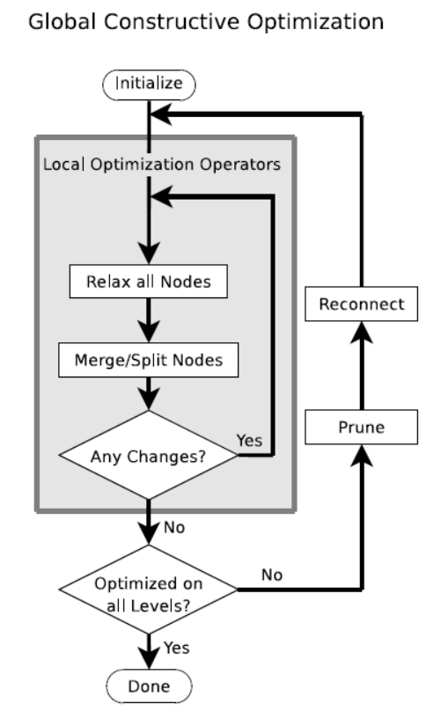
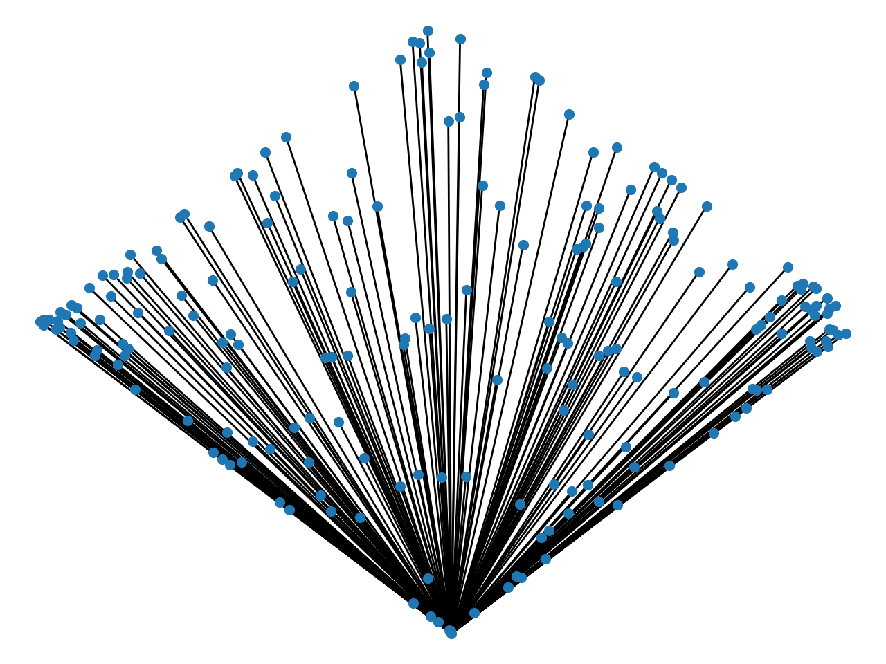
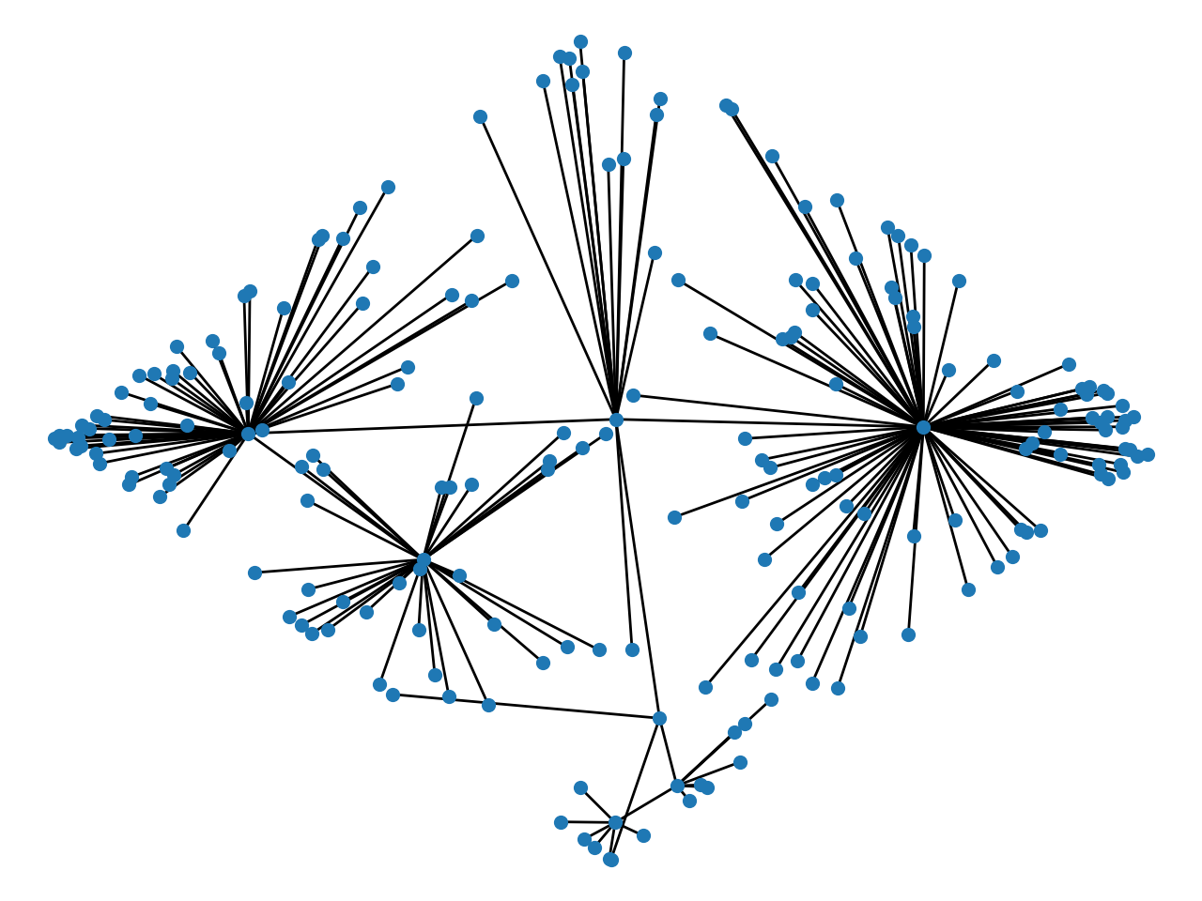
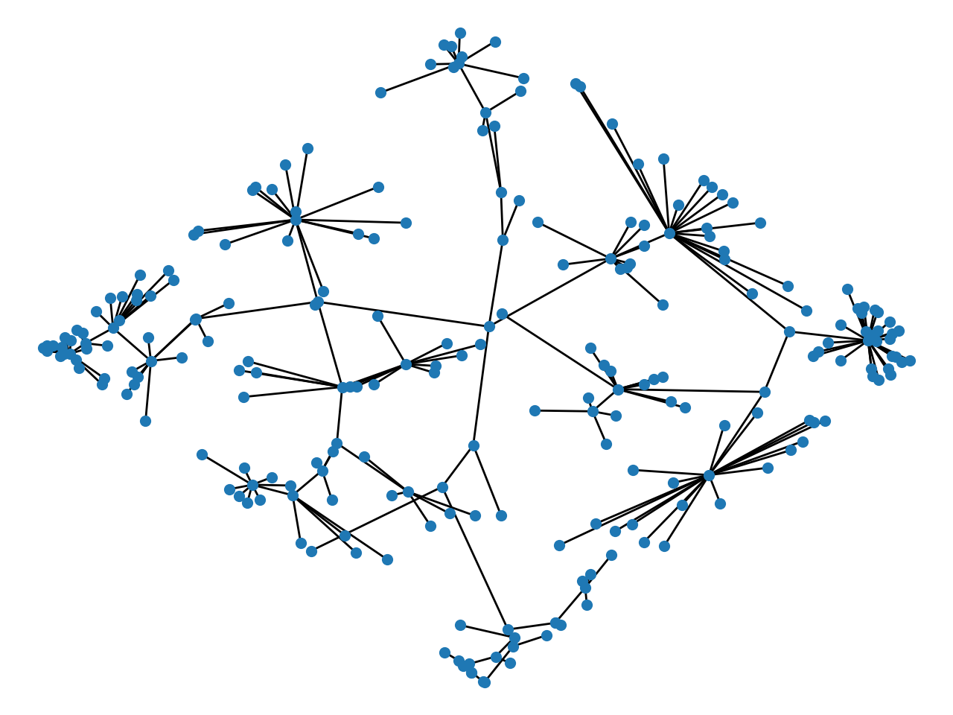
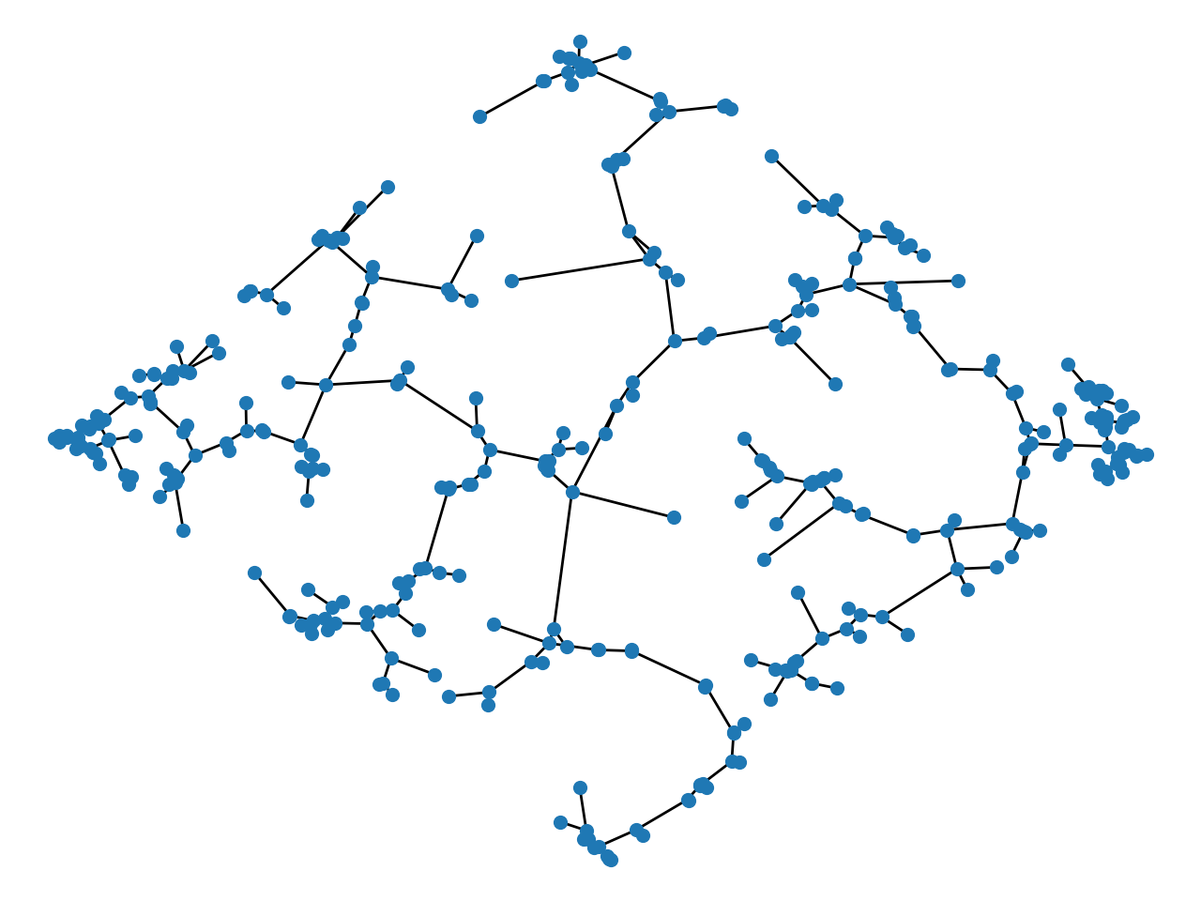
GCO Implementation (2D)
(1) Initialization
(2) Split
(3) Prune and Reconnect
(4) Result
Fig.13 GCO Algorithm

Slide 13
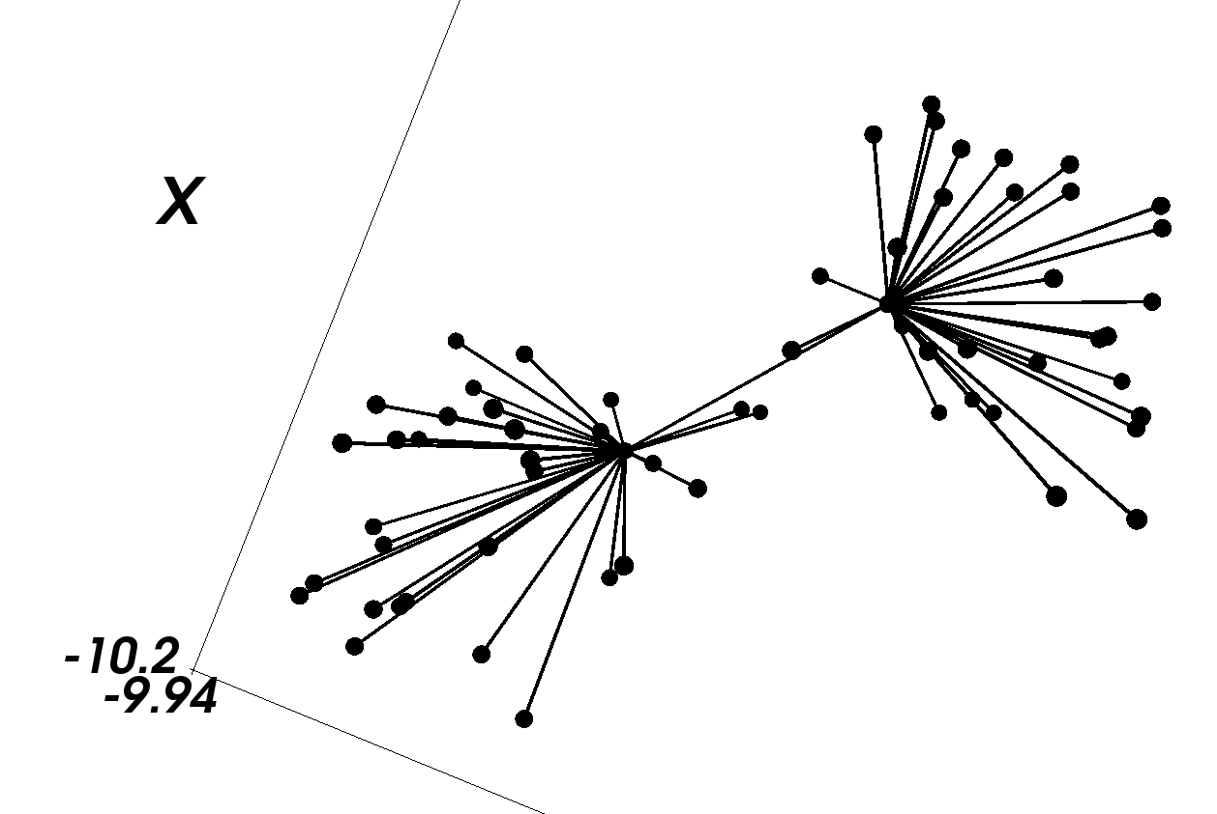
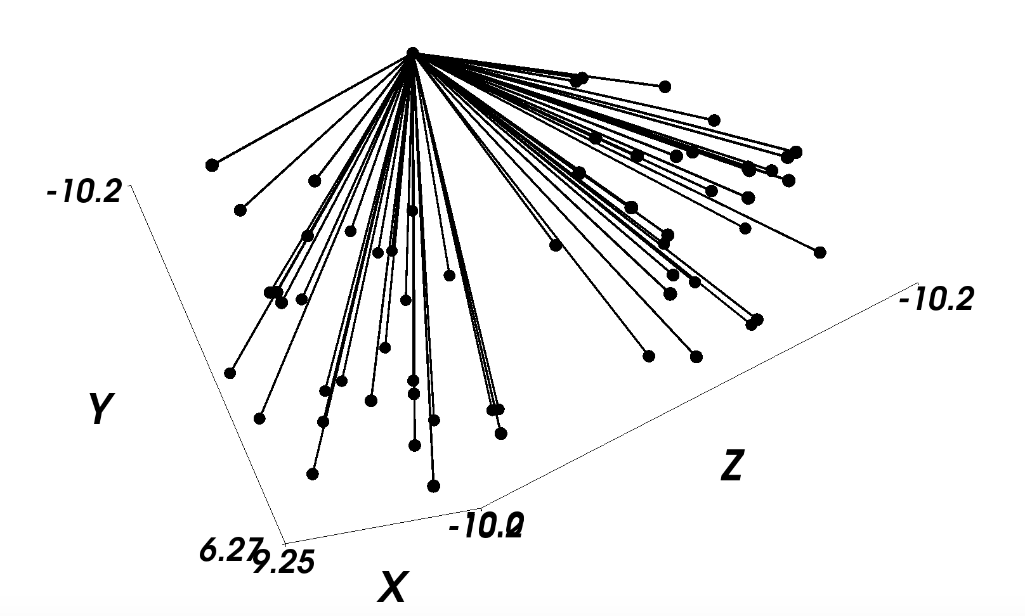
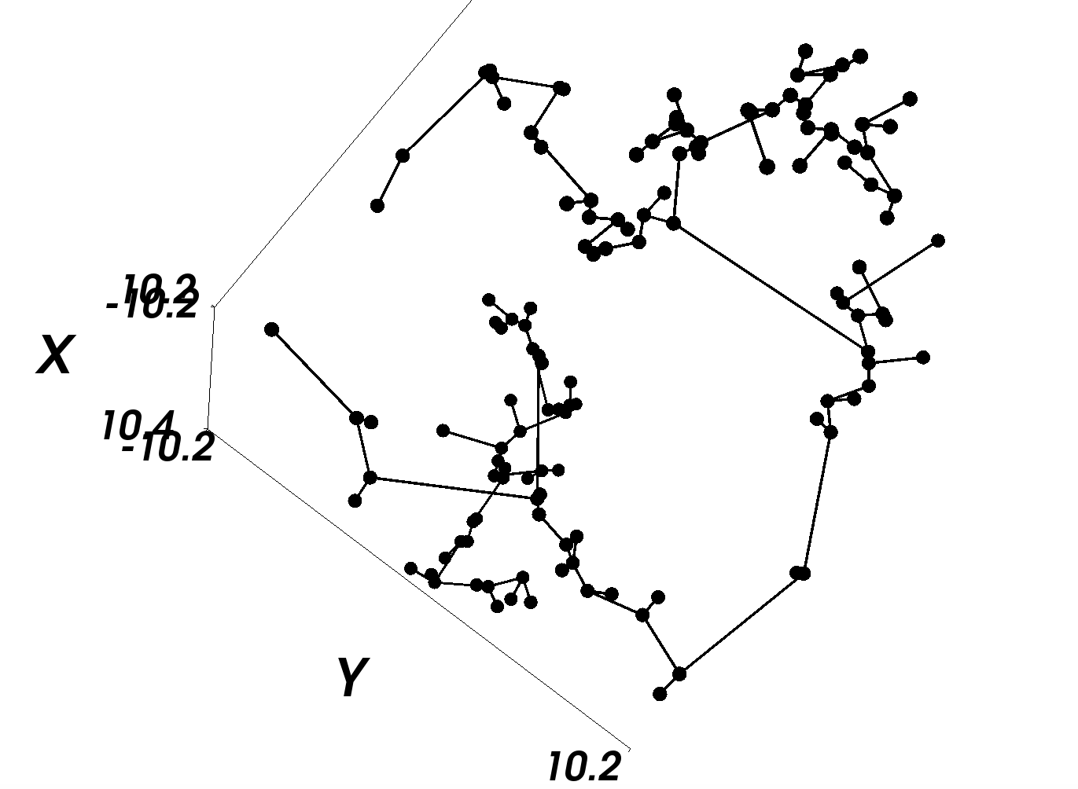
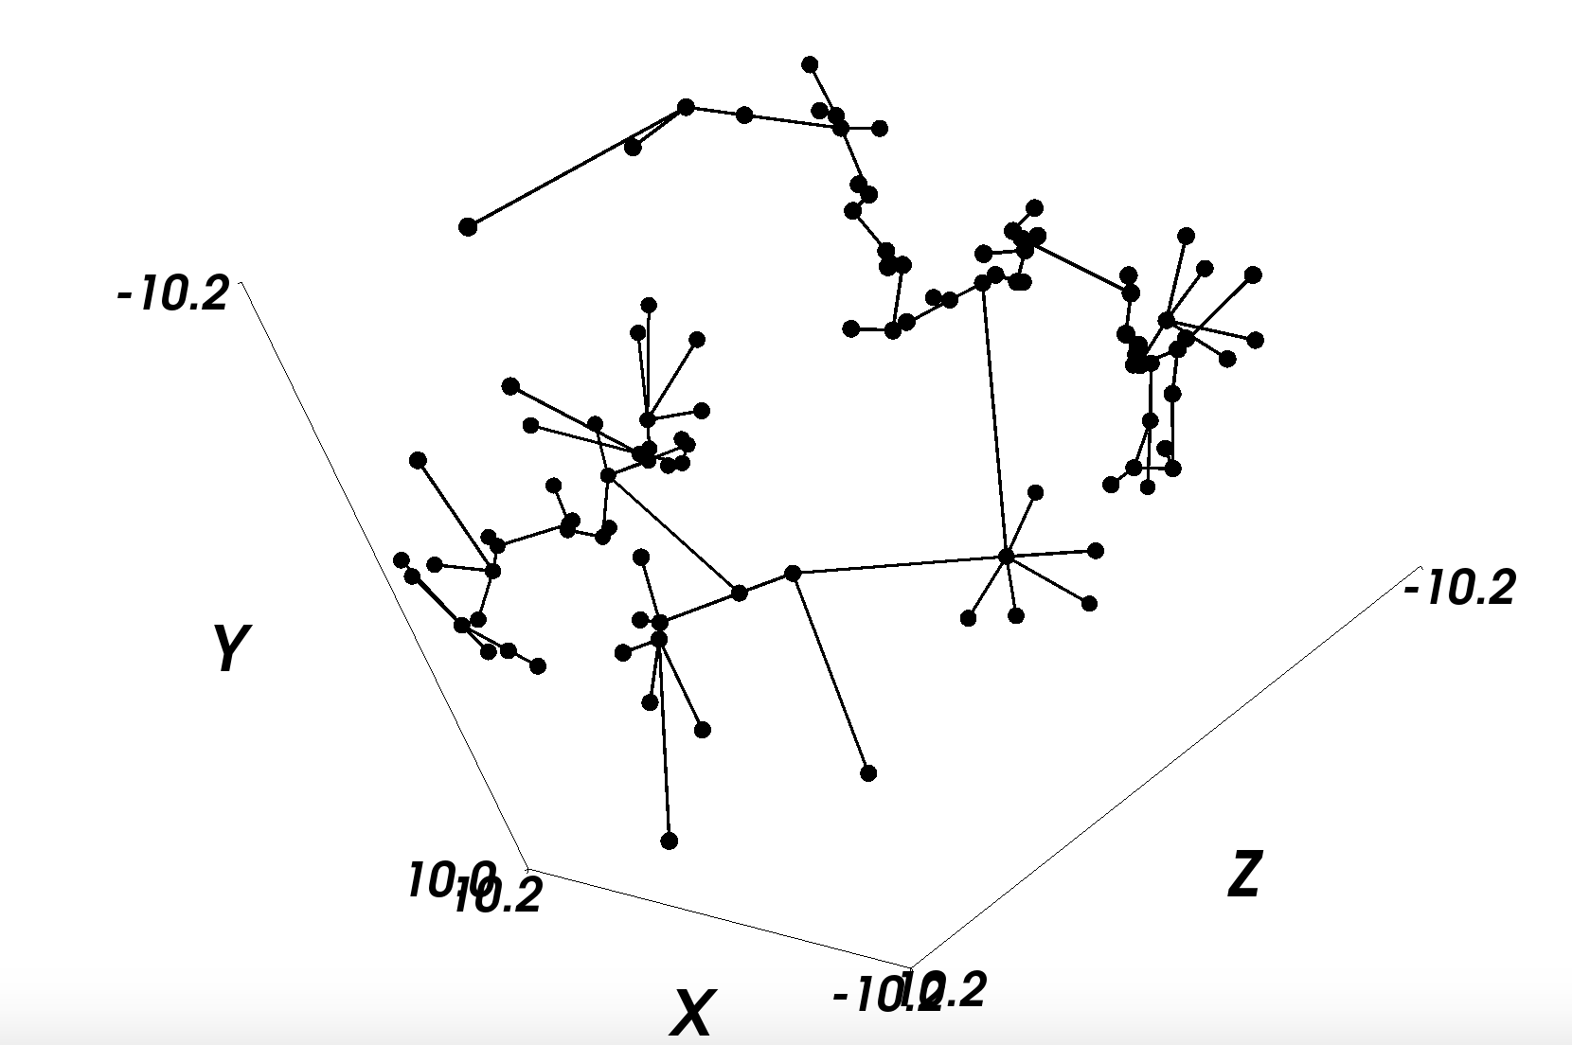
GCO Implementation (3D)
(1) Initialization
(2) Split
(3) Relax
(4) Result
Fig.14 GCO in 3D

Slide 14
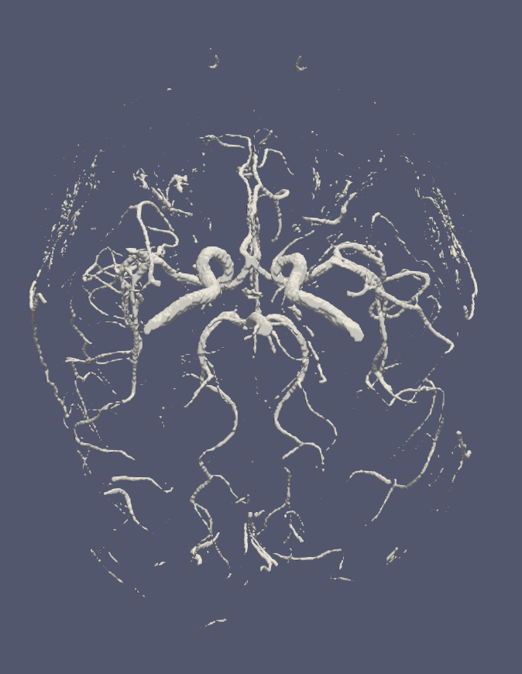
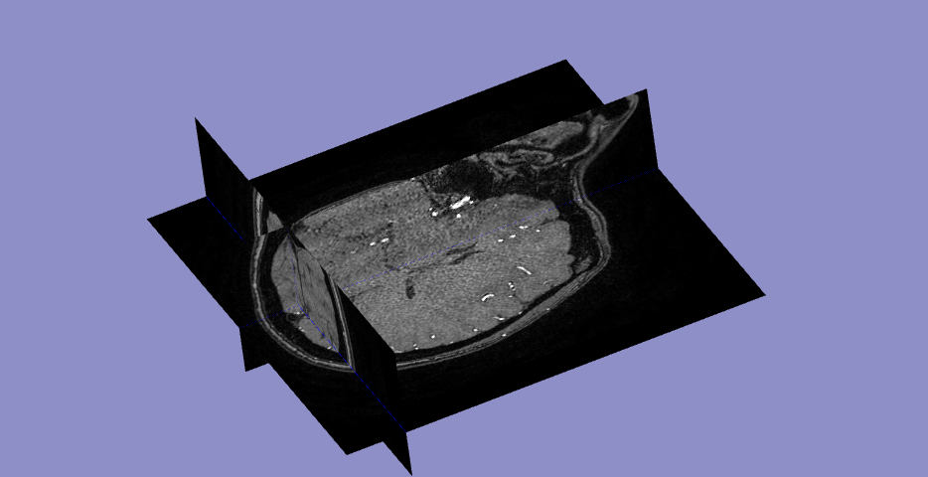
Locate Fixed Nodes: Extract Main Vessels
Brain vessel segmentation from angiography using NiftyNet
Fig.15 3D Brain Angiography
Fig.16 Segmented Vessel Mesh

Slide 15
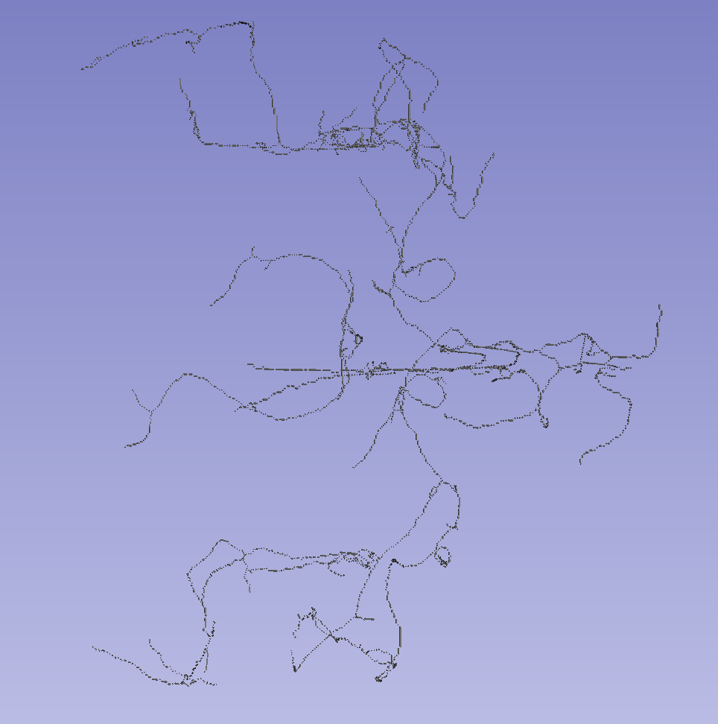
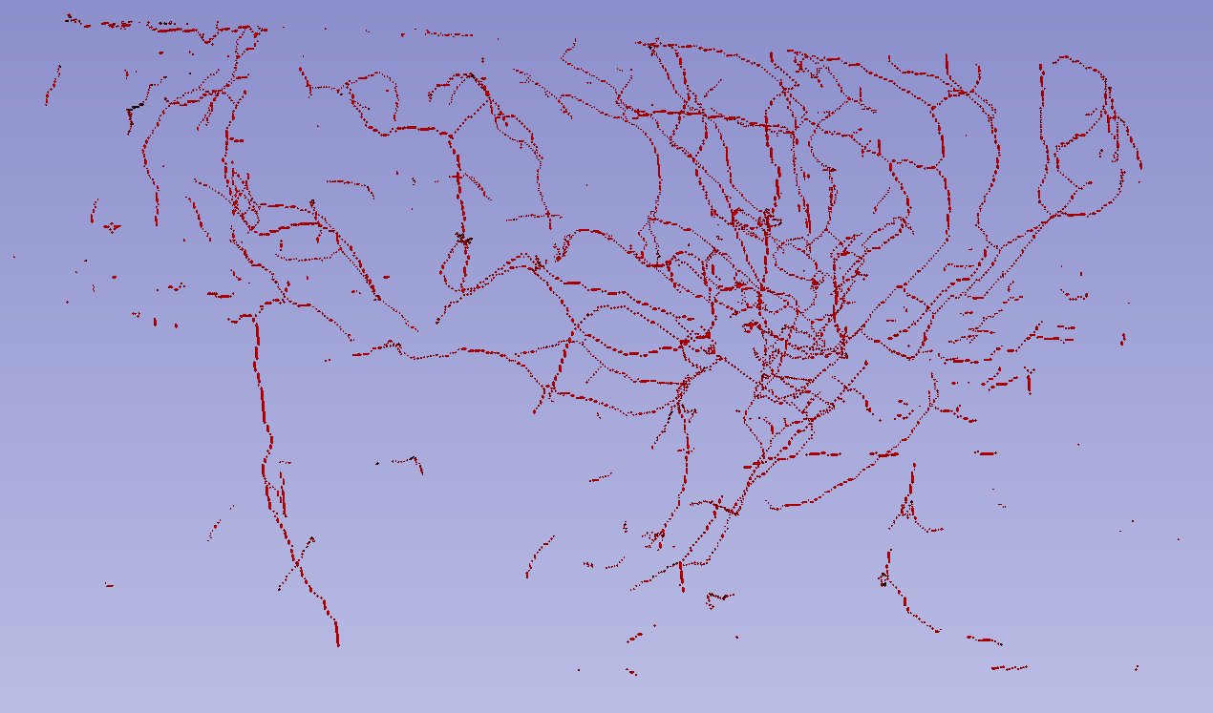
Locate Fixed Nodes: Extract Main Vessels
Voxelize: mesh -> 3D binary array
Connected component analysis: obtain two main vessels
Fig.17 Voxel Representation of Vessels
Fig.18 Voxel Representation of Main Vessel Parts

Slide 16
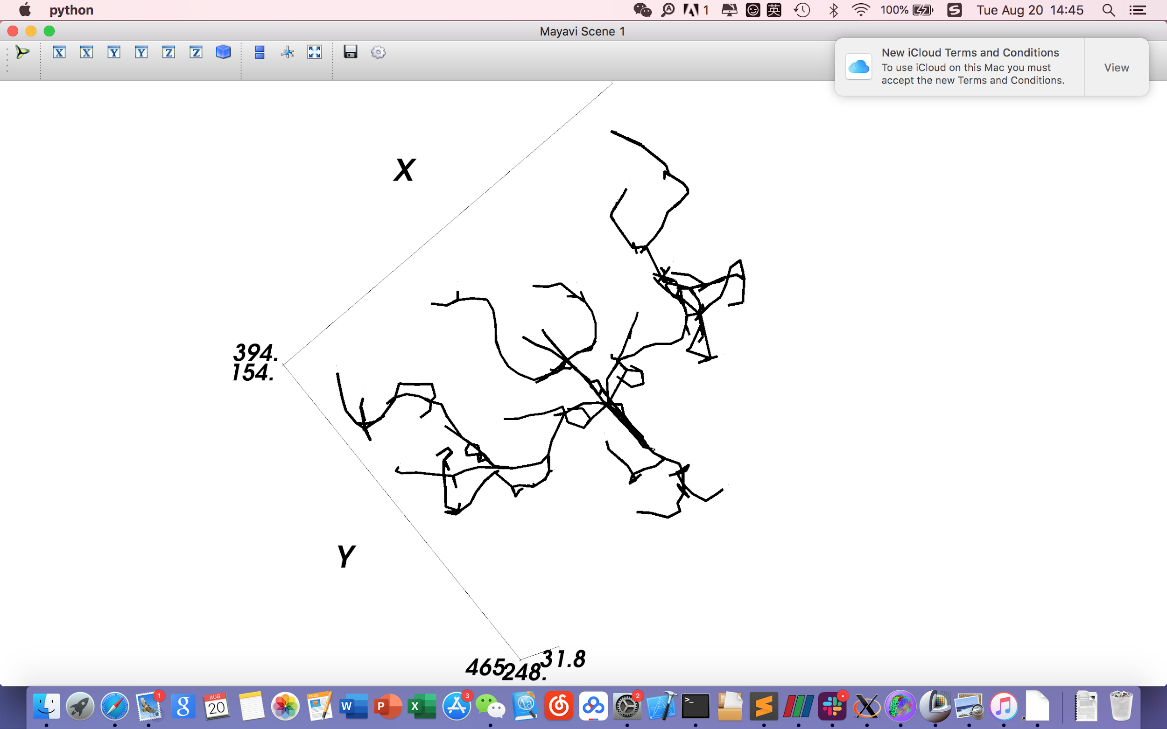
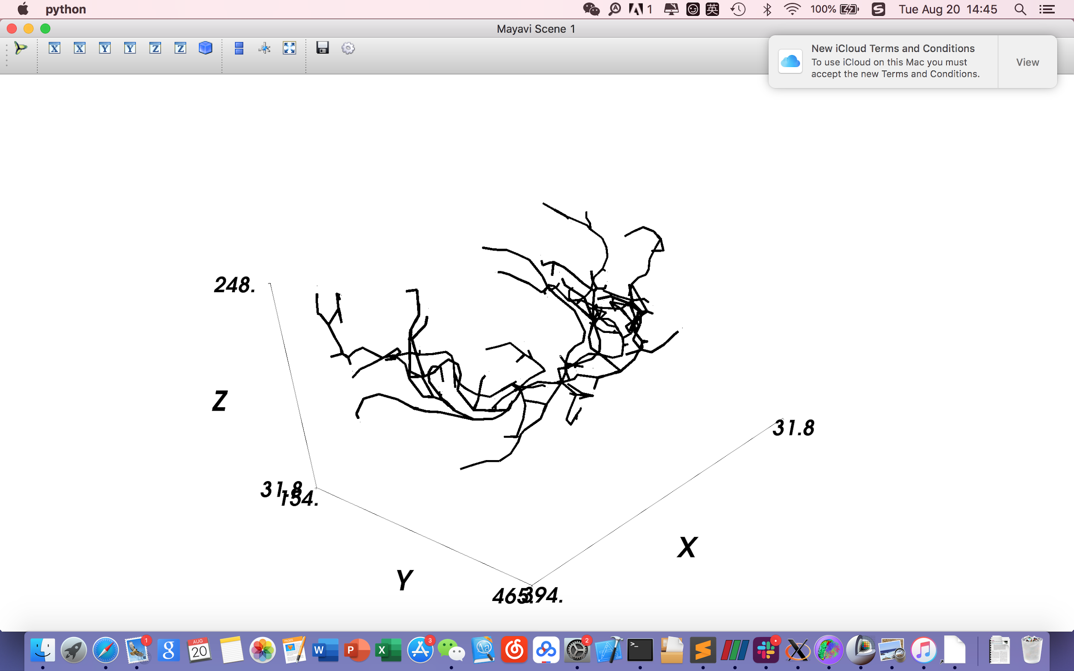
Locate Fixed Nodes: Node and Edge Representation
Sample points (coordinates) from the vessels to retain the main structure of the network
Fig.19 Node and Edge Representation of Main Vessels

Slide 17
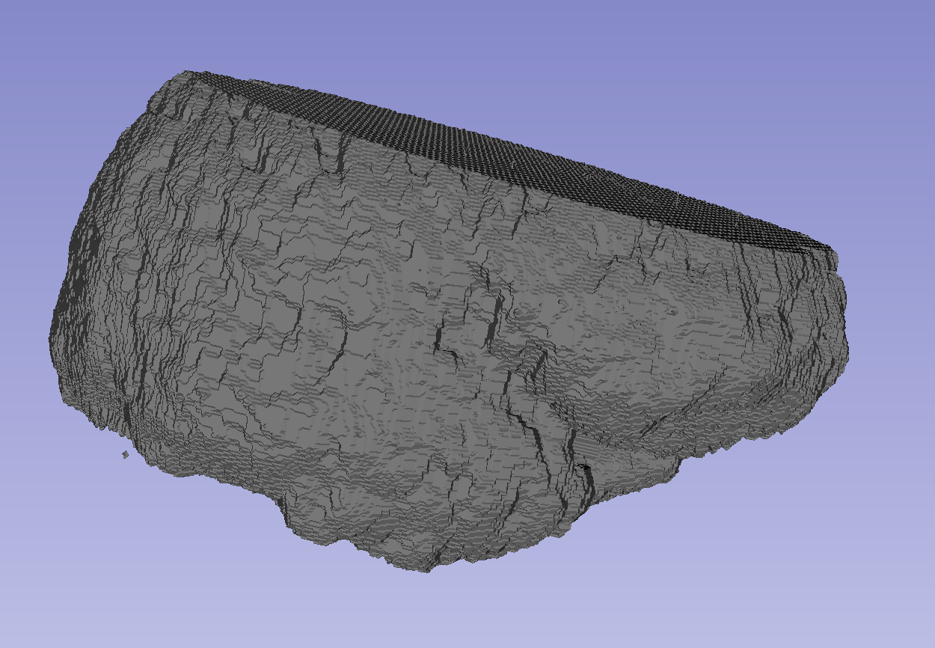
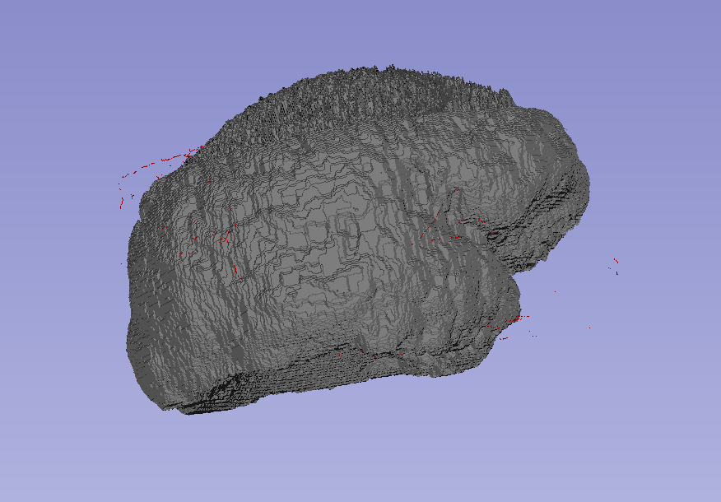
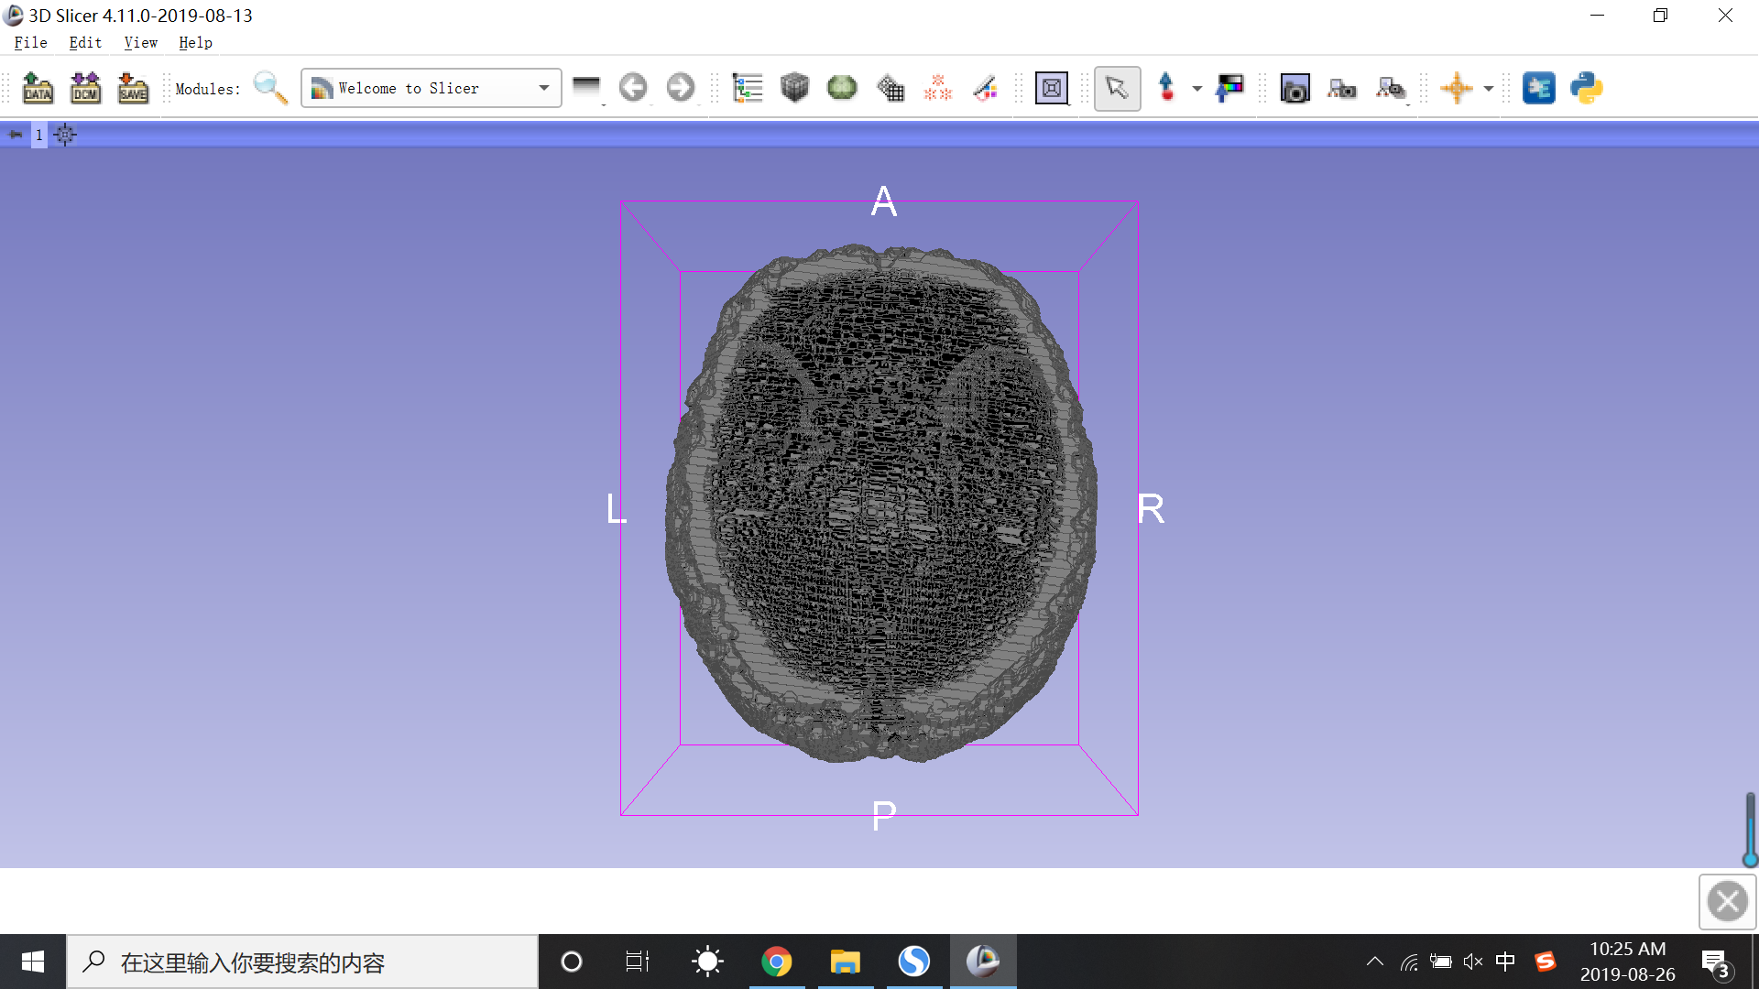
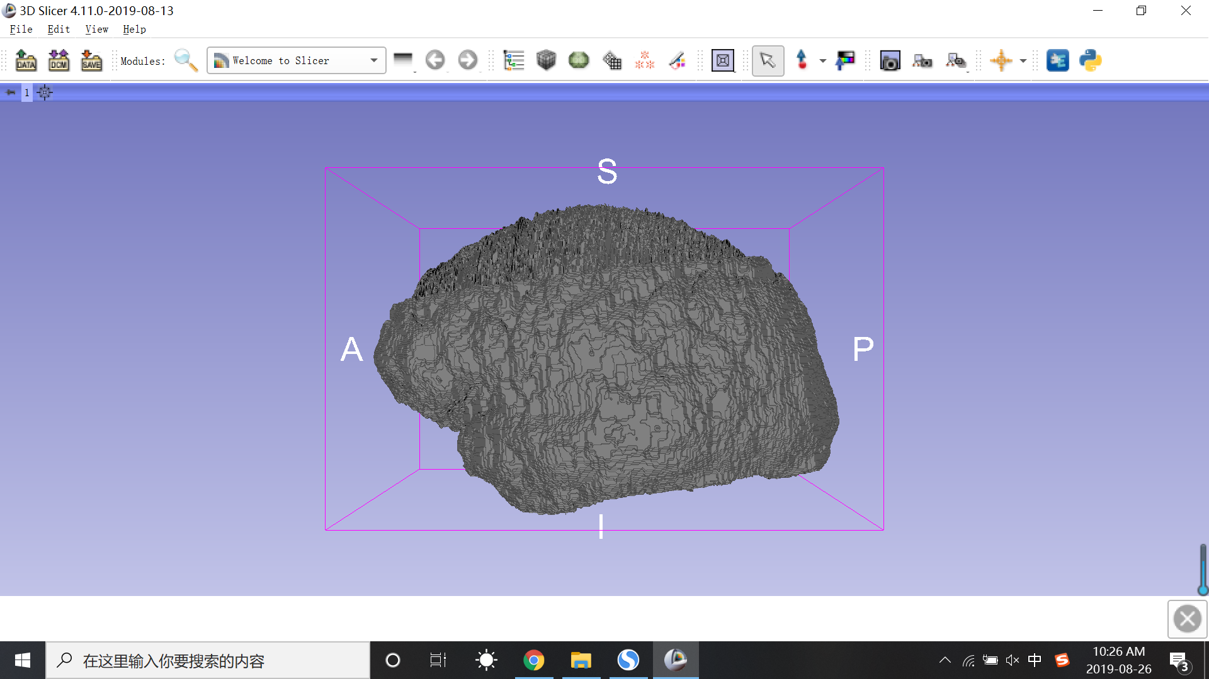
Sample Leaf Nodes: Parametrization
Fig.20 Brain Model Without Parametrization
Fig.21 Brain Model With Parametrization
Notes:
sample of entire volume of the brain
need to form a parametrized surface represents for the shape of a entire brain

Slide 18
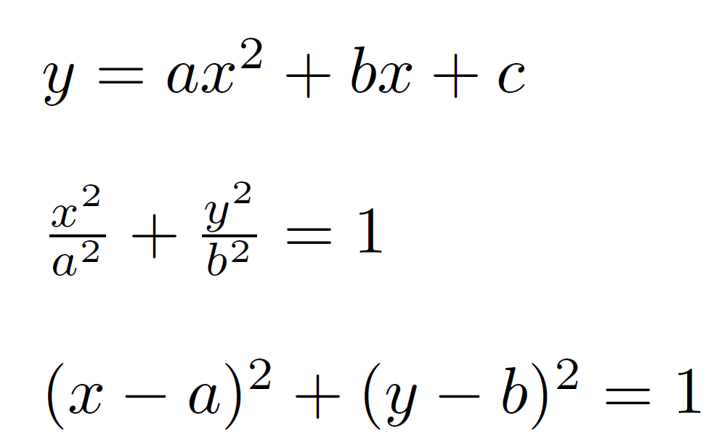
Sample Leaf Nodes: Approach
Take 512 slices and fit the curve with several mathematical expression.
Polynomial fit:
Ellipse fit:
Circle fit:
Notes:
voxel data, cut the 3d model into 2d slices
sample points from surface, fit a curve which is brain shape like
after done in each slice, fill up the missing part.
different forms of the curve

Slide 19
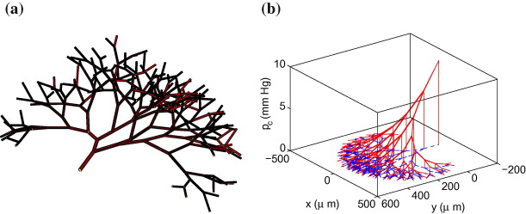
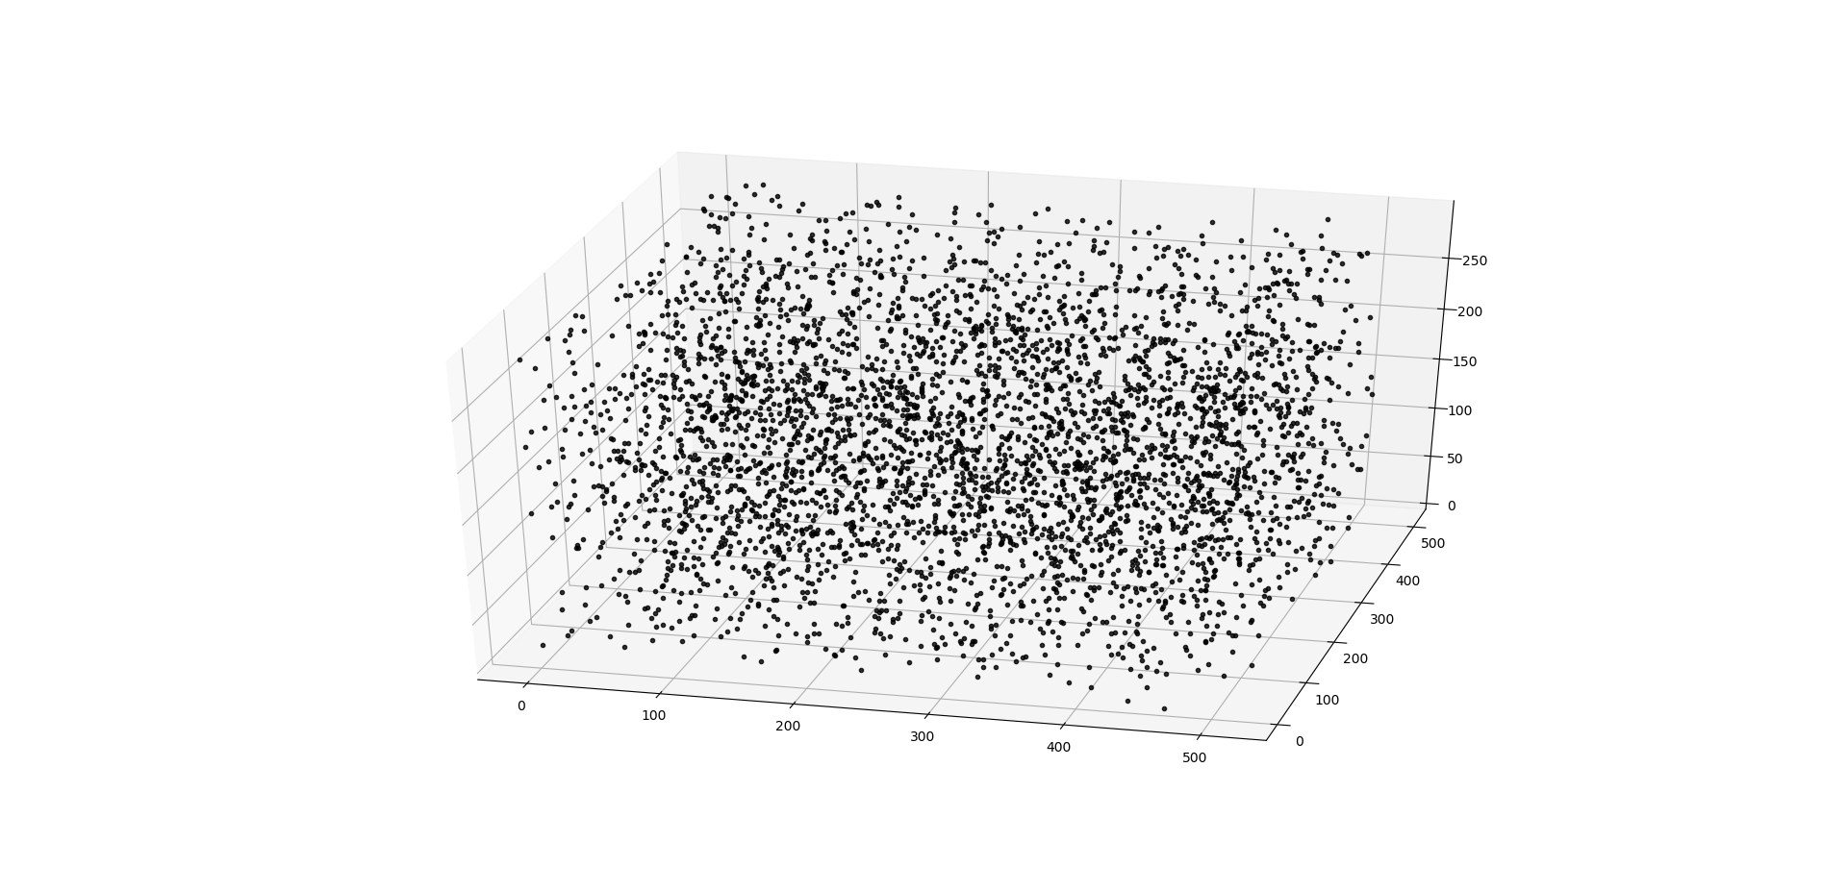
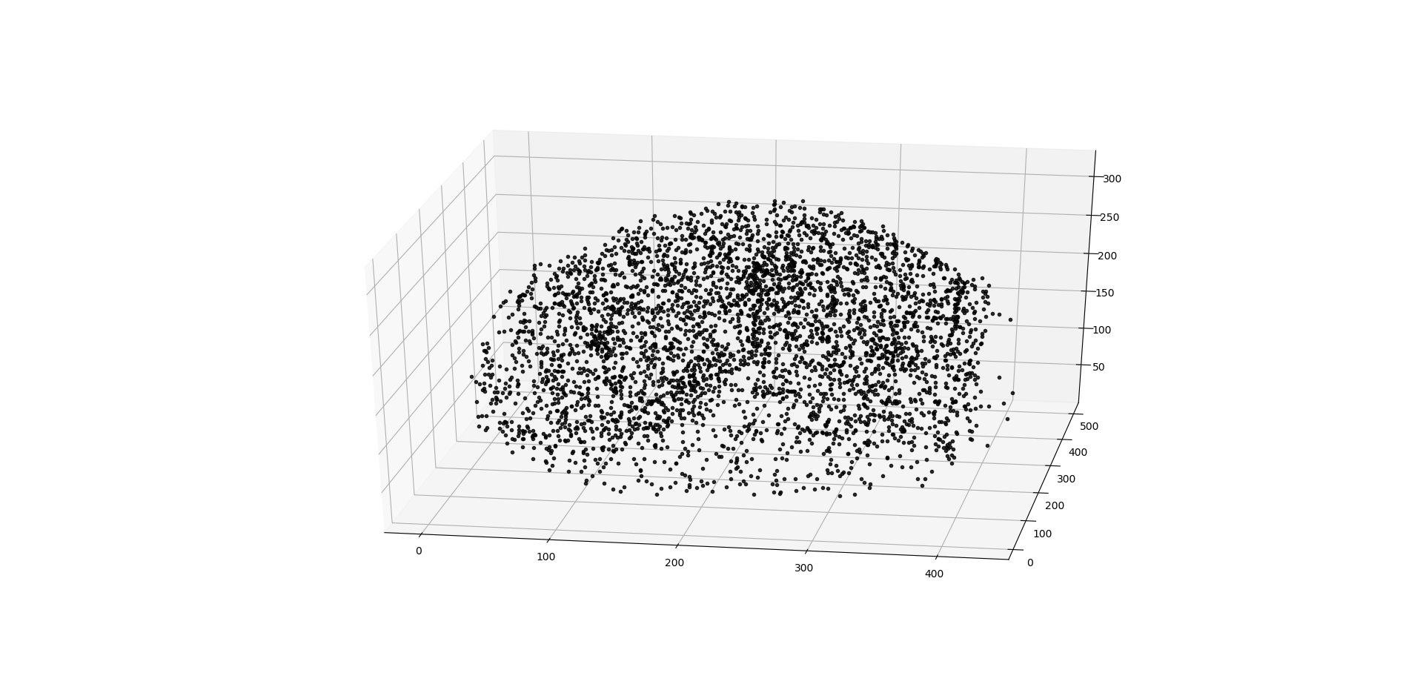
Sampling Algorithm: Region of Influence
Randomly sample some points in the domain and define a region of influence around each point
Rearrange the points to fill unsupplied regions
The Algorithm:
Find misses
Find overlaps + outliers
Move these points to missed regions
Add more points, if needed
Fig.22 Region of Influence Example

Slide 20
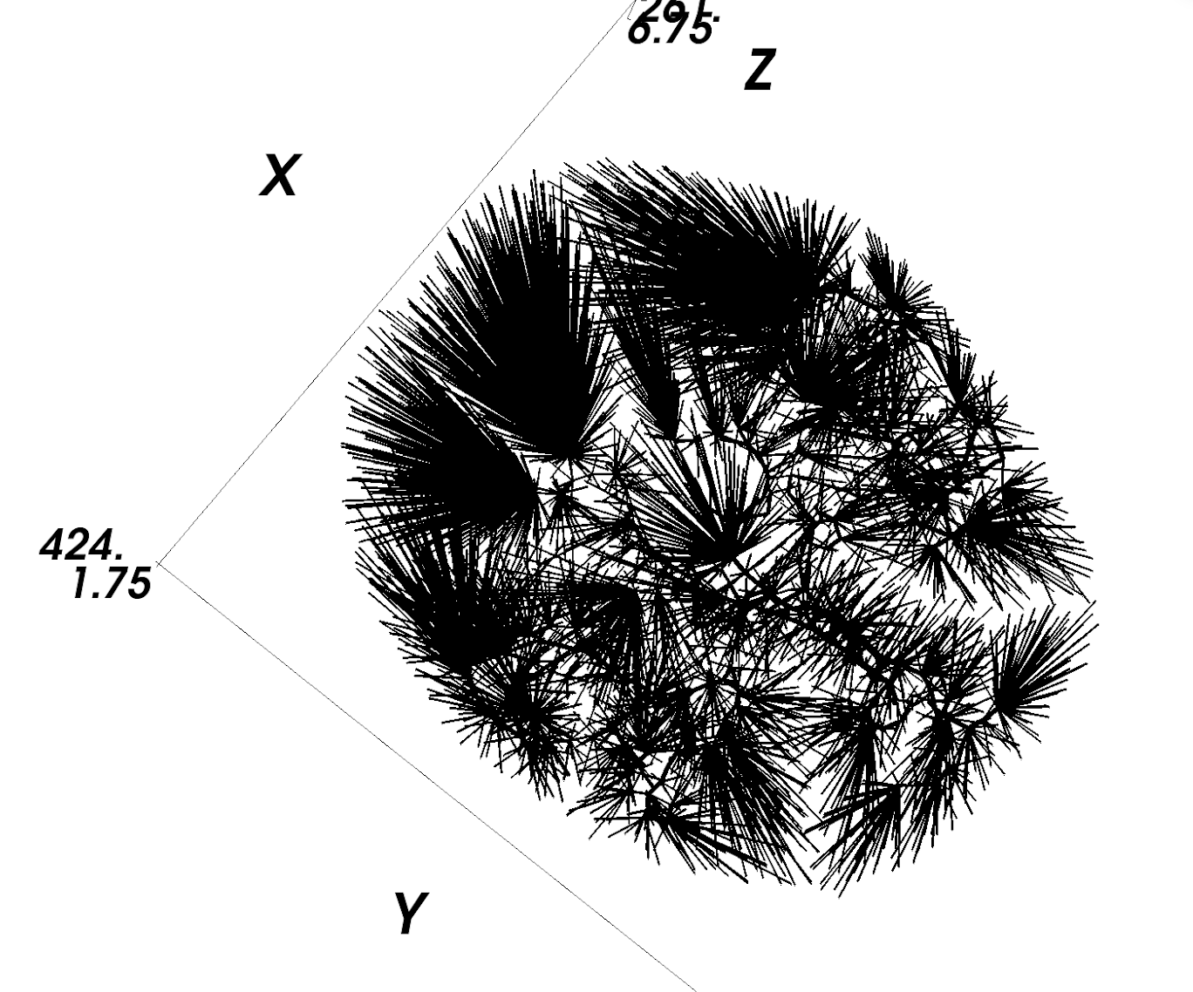
GCO Forest on Brain Vascular Network
Connect leaf nodes with nearest fixed nodes
Fixed node number: 1099
Leaf node number: 3016
Fig.23 GCO Forest Initialization

Slide 21
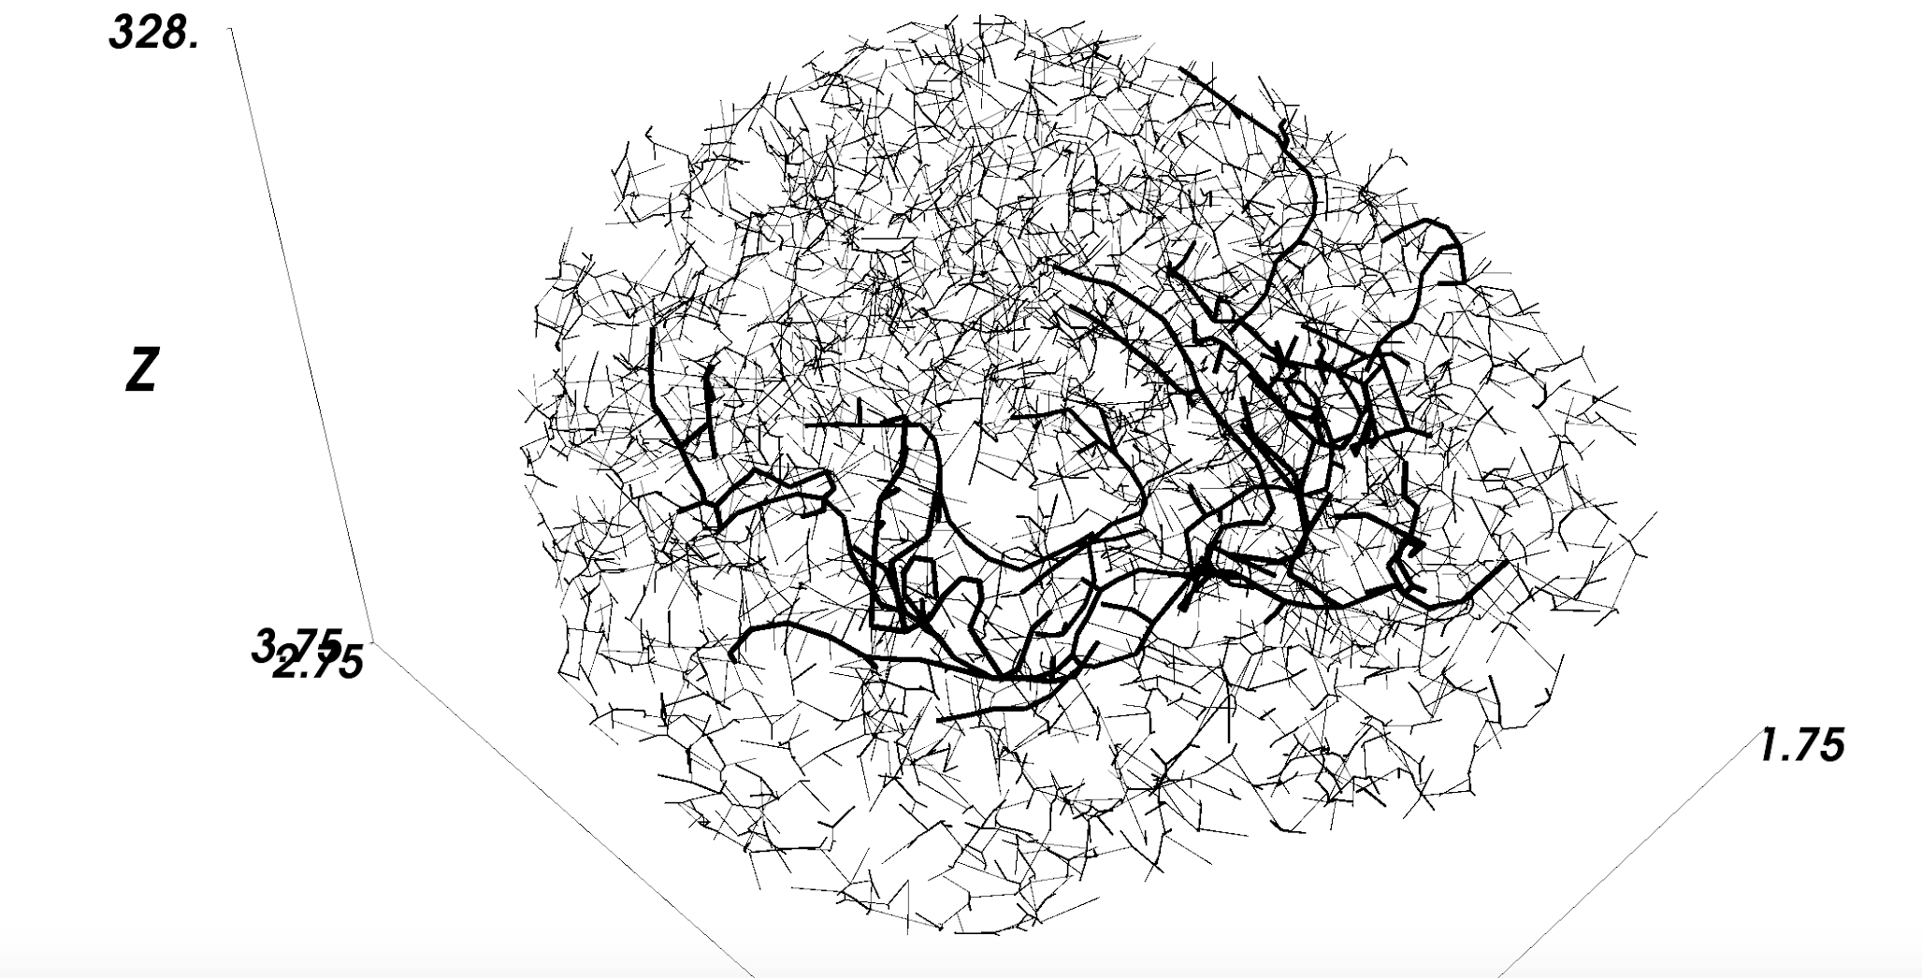
GCO Forest: Result
Fig.24 GCO Result

Slide 22
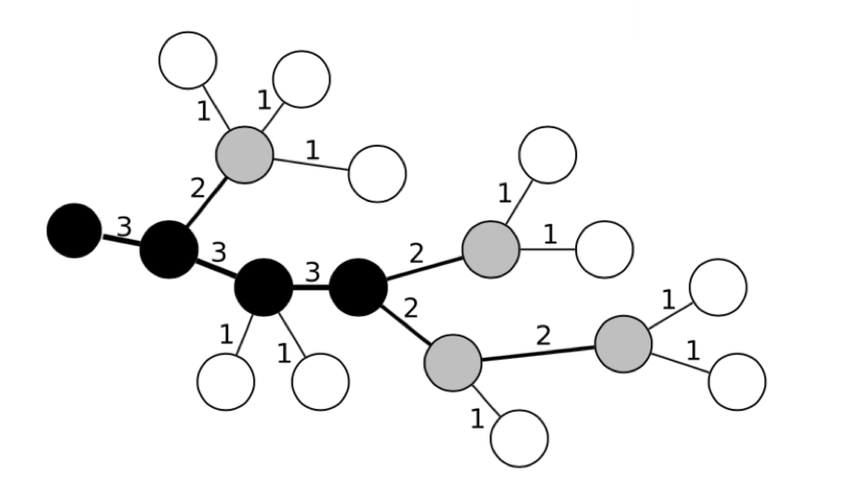
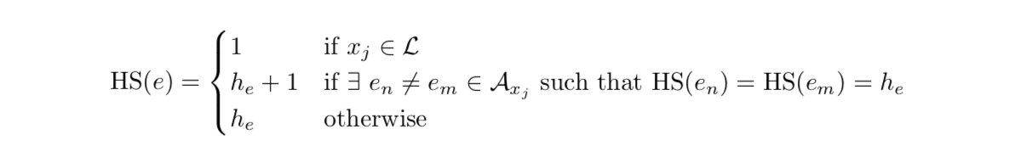
Characterize Trees: Horton-Strahler Order
Fig.25 Example of Strahler Order
Notes:
For each node we first find the max order of the daughters, if there is only one daughter,

Slide 23
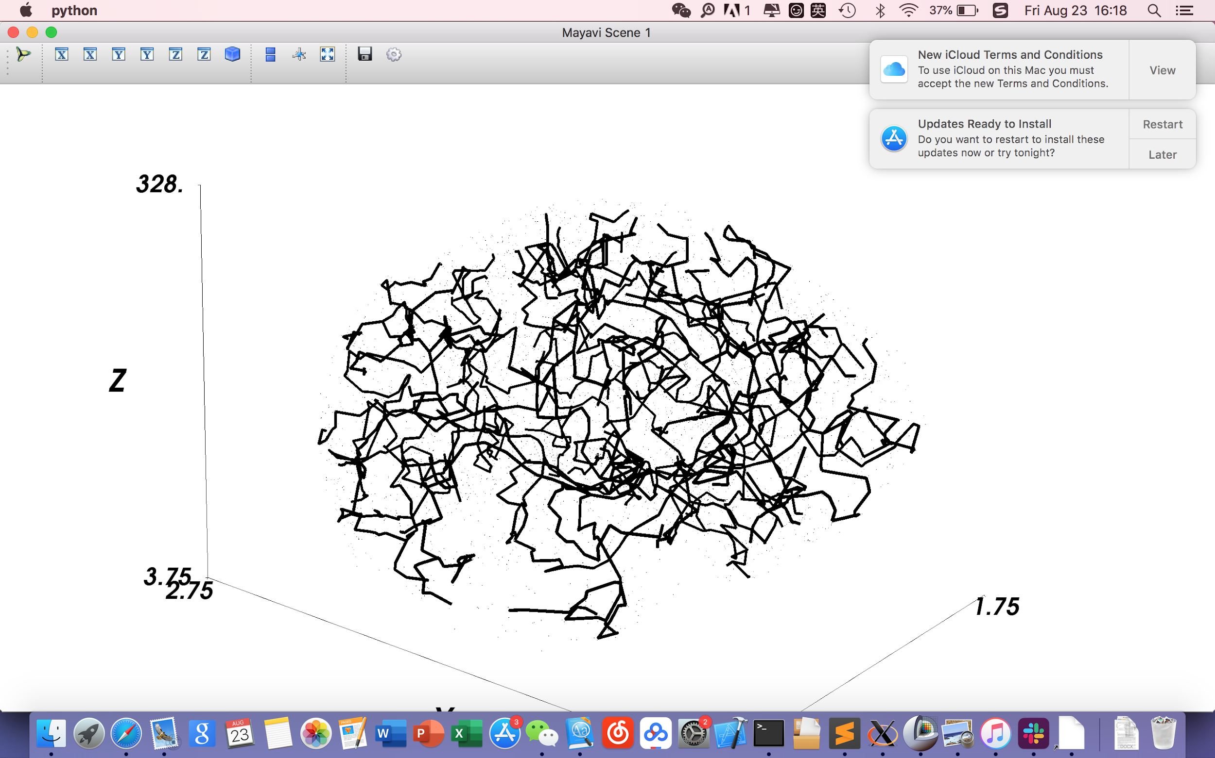
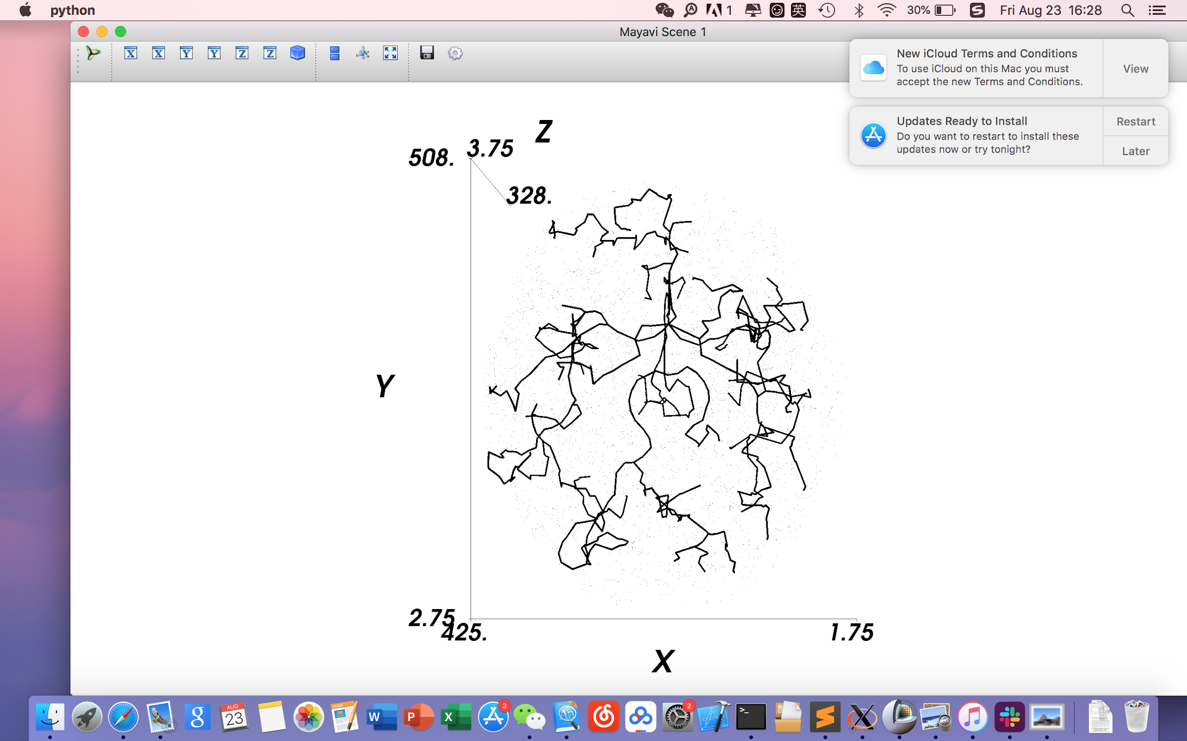
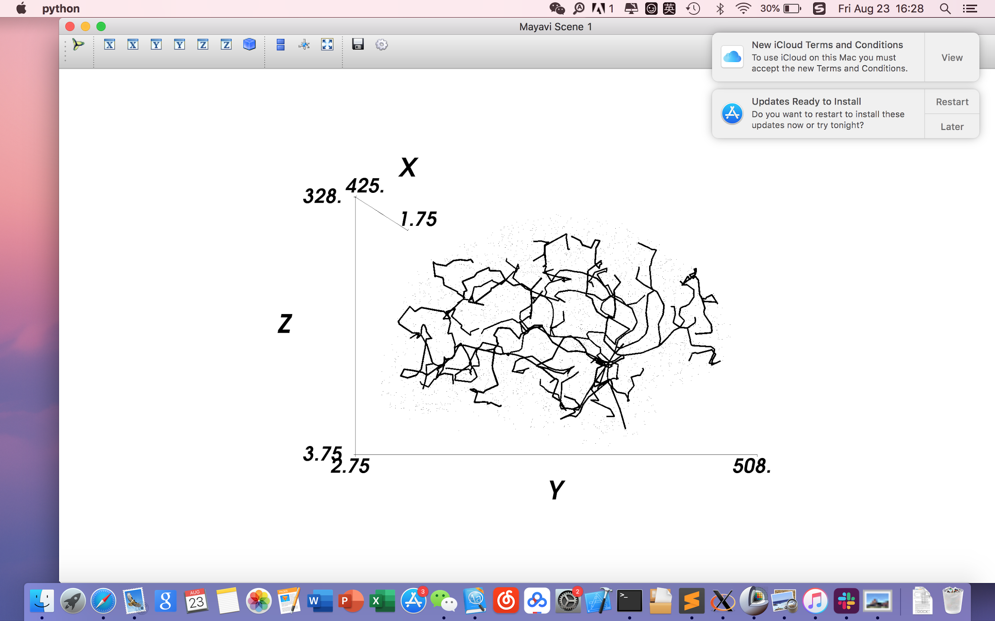
GCO Forest: Result
Vessels with Strahler order > 2
Vessels with Strahler order > 3
Fig.26 GCO Result

Slide 24
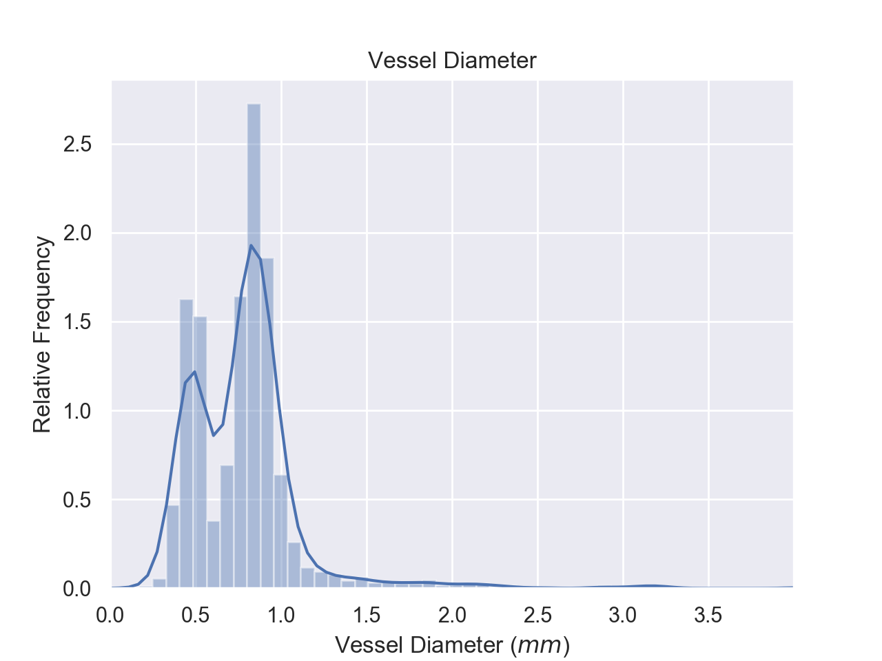
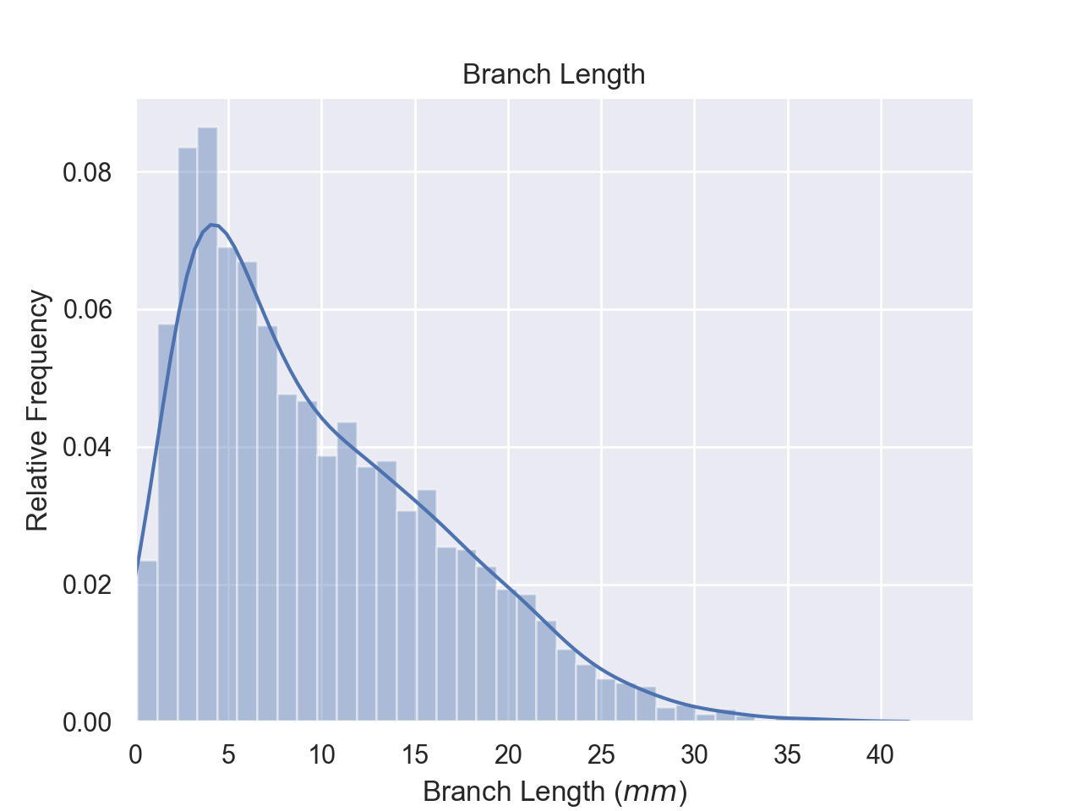
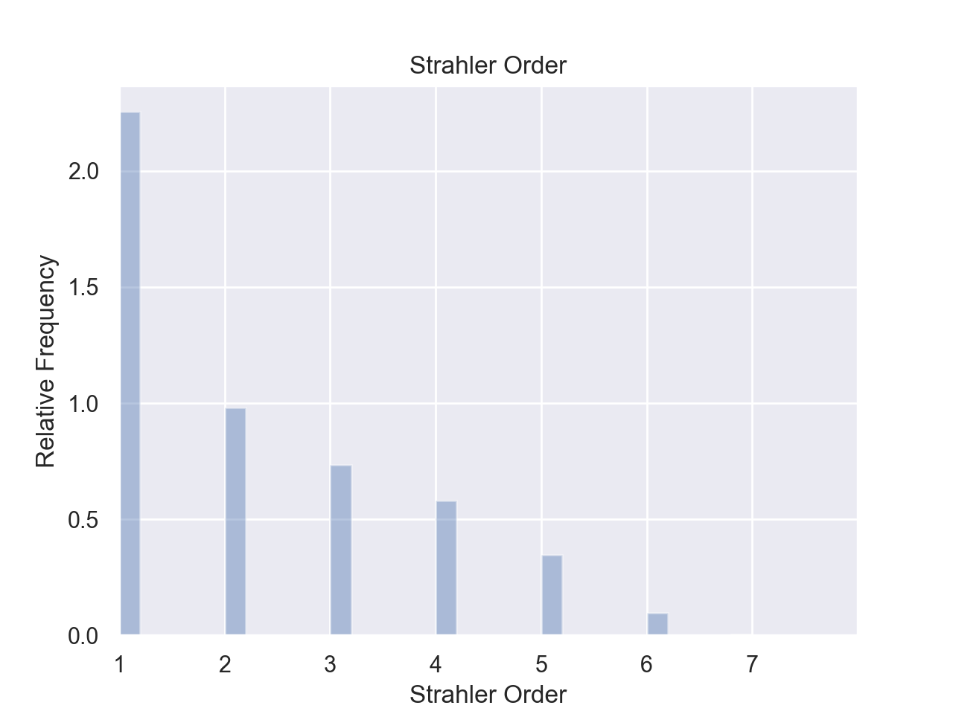
Result Analysis: Validation
Diameter / Branch Length / Strahler Order Frequency
Fig.27 Diameter Distribution
Fig.28 Branch Length Distribution
Fig.29 Strahler Order Distribution
Notes:
However we still have to validate whether the generated structure satisfies the physiological properties of brain vessels. We plot distribution of and alll of them are right skewed, which is in accordance with the situation in real brain data.

Slide 25
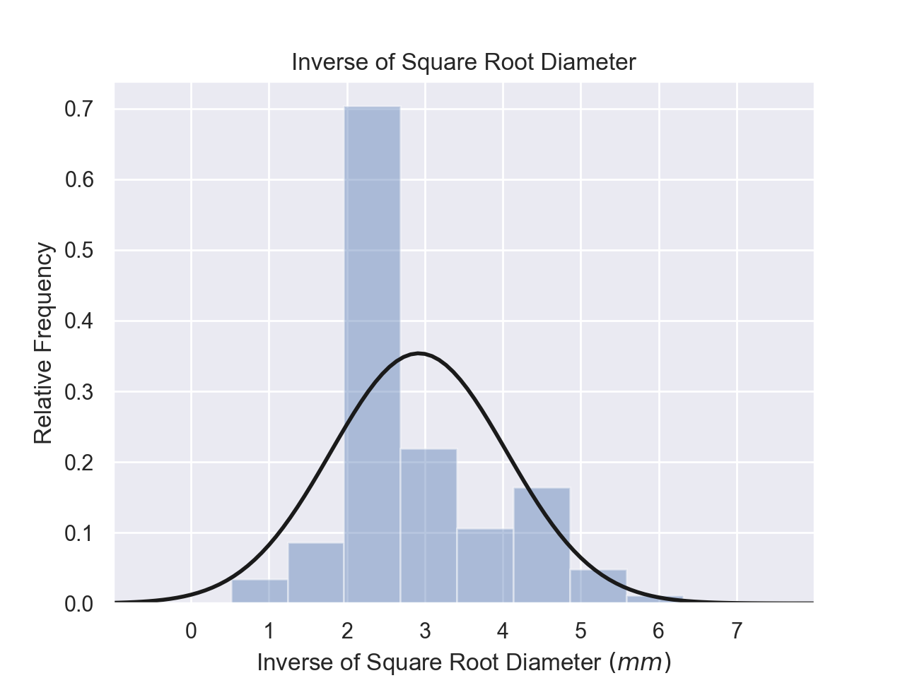
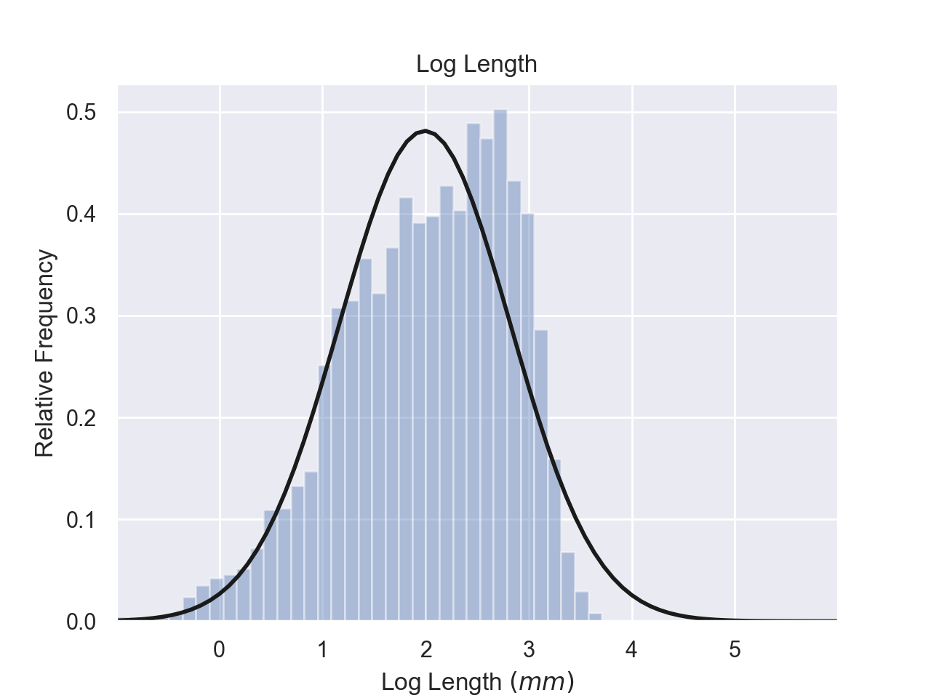

Result Analysis: Validation
Inverse Square Root of Diameter / Log Branch Length
Fig.30 Distribution of $1/{\sqrt{d}}$
Fig.31 Distribution of $\log{l}$

Slide 26
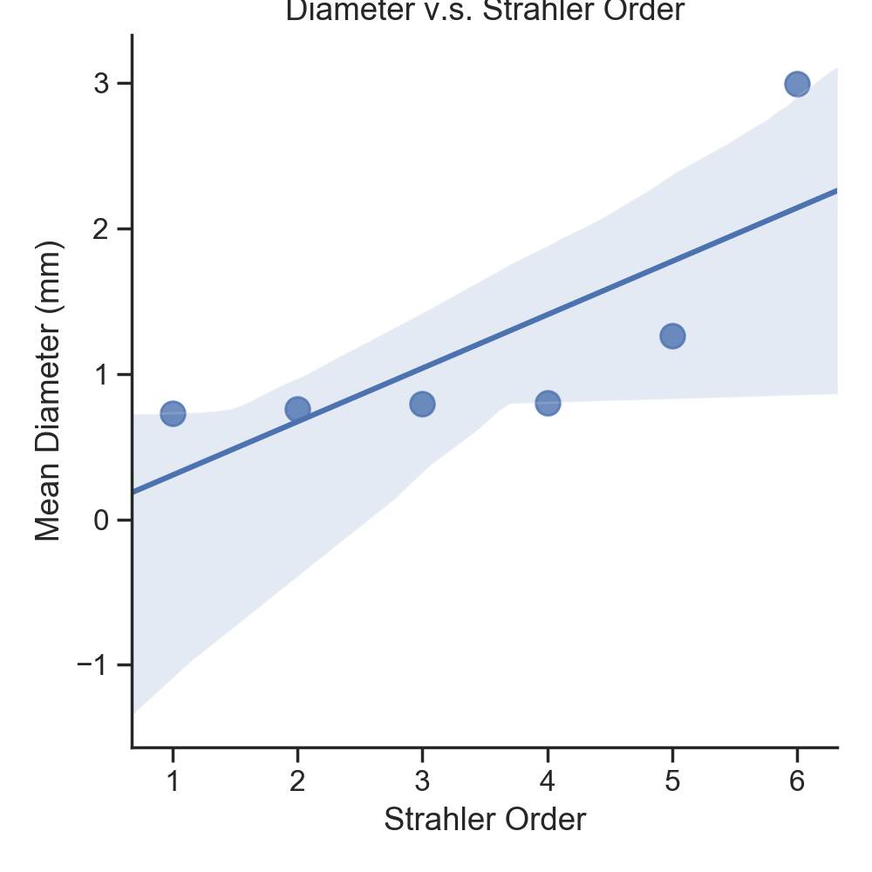
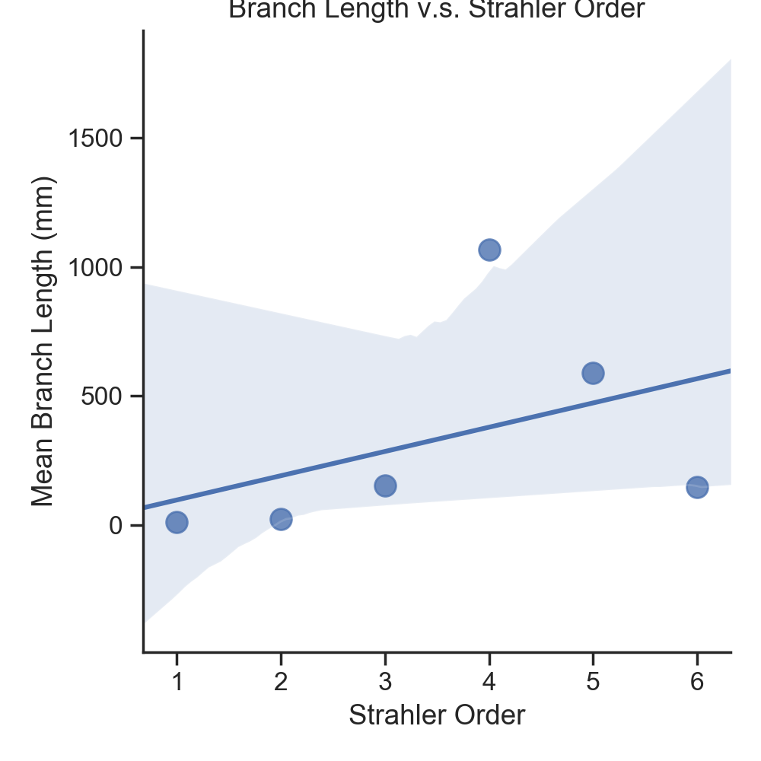
Result Analysis: Validation
Strahler Order v.s. Mean Diameter / Mean Branch Length
Fig.32 Mean Diameter for each HS order
Fig.33 Mean Branch Length for each HS order
Notes:
They follow the linear relationship that is summarized in previous papers.

Slide 27

Analysis: 3D Visualization of Final Model
Fig.34 Reconstructed 3D Brain Model

Slide 28

Analysis: Blood Flow Modelling
Mesh generation
Geometry needs some cleansing before performing actual calculations
Aim: model the flow to get pressure distribution and wall shear stress and compare it with actual data
Fig.35 Reconstructed Vessel Model

Slide 29
Future Work
Further modelling of blood flow and shear stress
Incorporate vesselness map into Simulated Annealing algorithm
Incorporate physiological properties into cost function

Slide 30
Acknowledgement
Special thanks to the FIELDS Institute for organizing the program!
We feel indebted to Dr. Nima Maftoon and his PhD student Sina Anvari Naeini for guiding us in the completion of the project!

Slide 31
Thanks!

